Slide 1
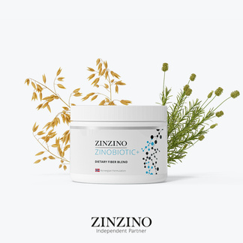

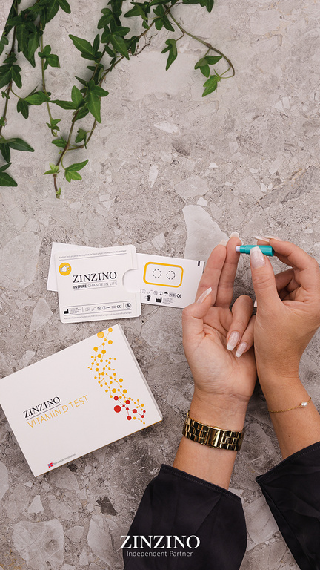
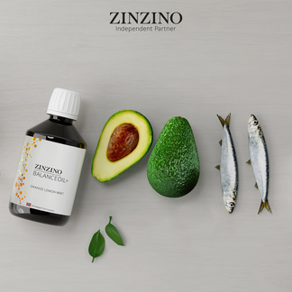
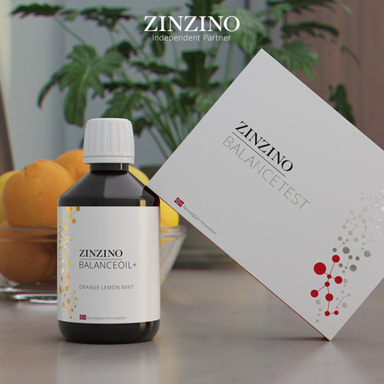

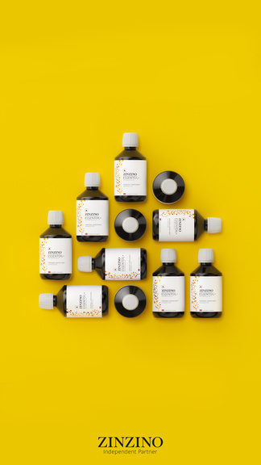


The Future of Personalized Health
Test-Based Nutrition & Zinzino
Notes:
Hi everyone—I’m Heather Nianouris, coming to you from my home office in Dayton, Ohio, and I’m really glad you’re here.
Let me give you some quick context.
I spent 12 years in social selling—helping everyday people build income by sharing products they love. I built a global team of over 10,000 and was one of the top leaders at my former company.
But last July, the rug got pulled out from under us. The company shifted directions overnight, and just like that… years of income disappeared.
It made us pause. Reevaluate.
My husband and I made a list—an actual list—of what it would take to start again. And honestly? The bar was high.
We weren’t looking for hype. We wanted substance.
Something testable, credible, and disruptive in all the right ways—something that would speak to both everyday people and professionals.
That’s when we found Zinzino.
This wasn’t just another supplement company—it was a whole new way of thinking about wellness.
And the deeper we got in, the more I realized…
I wasn’t starting over.
I was leveling up.
And that’s what I want to show you today:
✔ Who Zinzino is—and why you haven’t heard of them yet
✔ What test-based nutrition means—and why it matters
✔ How this creates a better path for health and income
✔ And why timing is everything right now
Let’s get into it.

Slide 2


01
Does it solve a real problem?
INTRODUCTION
“If you’re going to invest your money, your time, or your energy, you need a system for evaluating it—not just hope and emotions.” - Ray Dalio
02
Is the timing right?
03
Is the company solid?
04
Can I win here?
02
Notes:
Before we get into the details, let me start with this:
I’m not here to talk you into anything.
I’m here to help you make a smart decision—for YOU.
Because let's be honest: —every opportunity costs something.
If you say yes, it costs time and focus.
If you say no, it might cost you a shot at something that could change your life.
So I made myself a promise: I wouldn’t move forward unless it passed four key questions.
First—does it solve a real problem?
If this didn’t meet an actual need in the world, I wasn’t interested.
No one needs more hype or more clutter.
Second—Is the timing right?
Are we early enough to catch the momentum—not just watch it pass?
Third—is the company solid?
Will it still be standing in five years? Ten?
And finally—can I win here?
Not just the top 1%.
But real people. With real lives.
If even one of those had been a no—I’d have walked away.
But what I found?
Was four very clear yeses.
So over the next few minutes, I’m going to walk you through those questions.
And by the end, you’ll have everything you need to decide if it’s a yes for you, too.

Slide 3
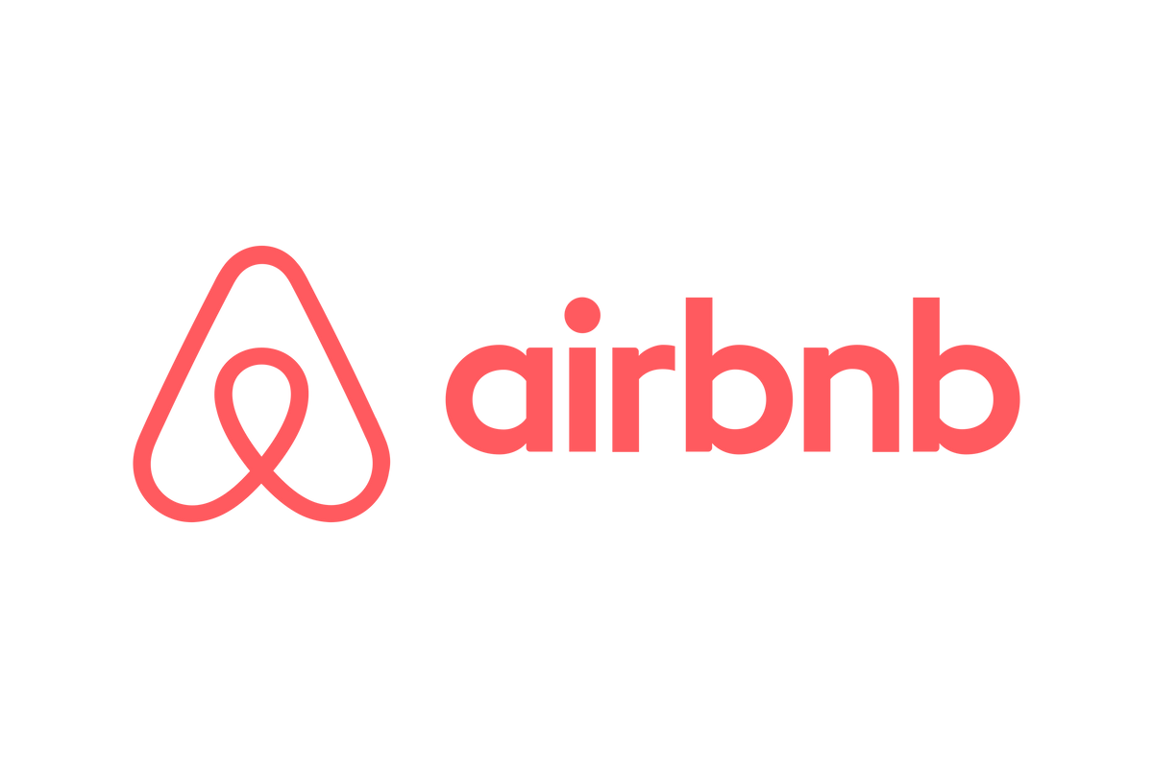
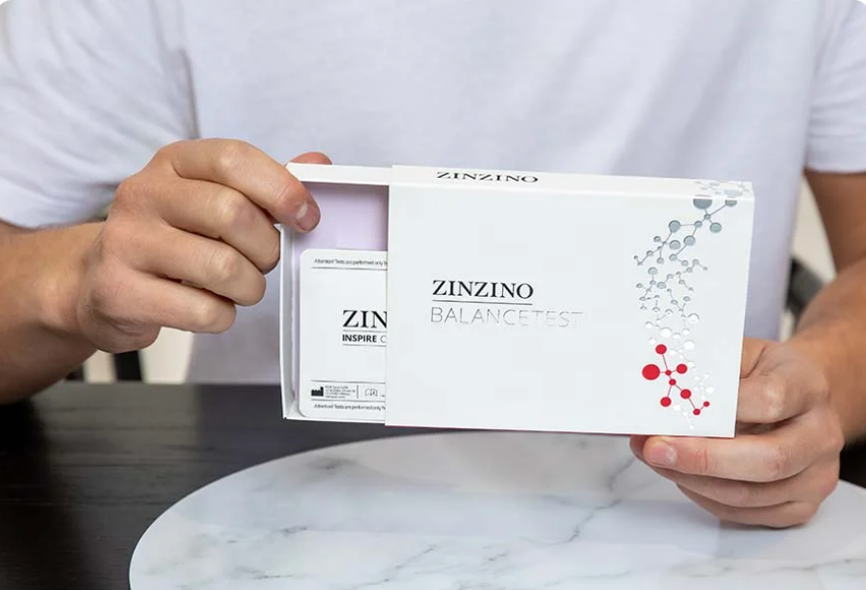

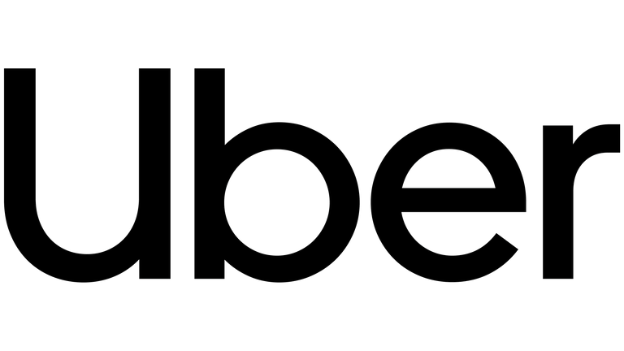
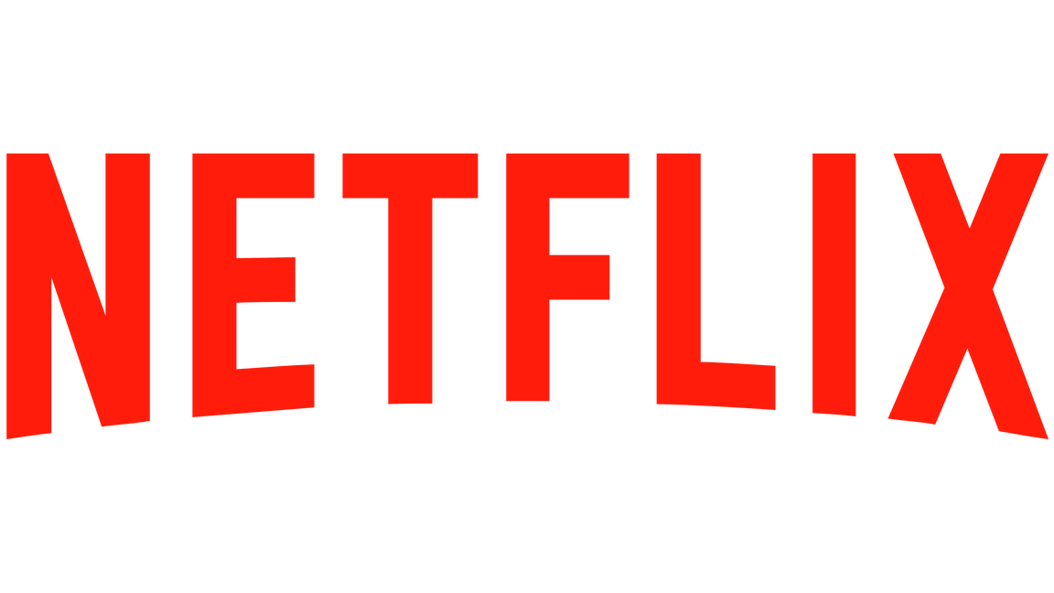
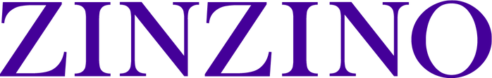
THE PROBLEM
The biggest business opportunities solve problems no one else is solving
next
Notes:
Here's the truth: The most powerful companies didn’t win because they had the flashiest brand.
They won because they solved a problem no one else was solving.
And they made life better for us.
Airbnb turned spare bedrooms into income.
Uber made it easier to get around—no rental counter, no guessing.
Amazon gave us back our time. One click. Done.
None of us were asking for those things…
until we experienced them.
And now? We’d never go back.
That’s what real disruption looks like.
Companies that change how we live—by solving problems we didn’t even realize we had.
And that’s exactly what Zinzino is doing in the nutritional space.
We're fixing something that’s broken in the wellness world.

Slide 4
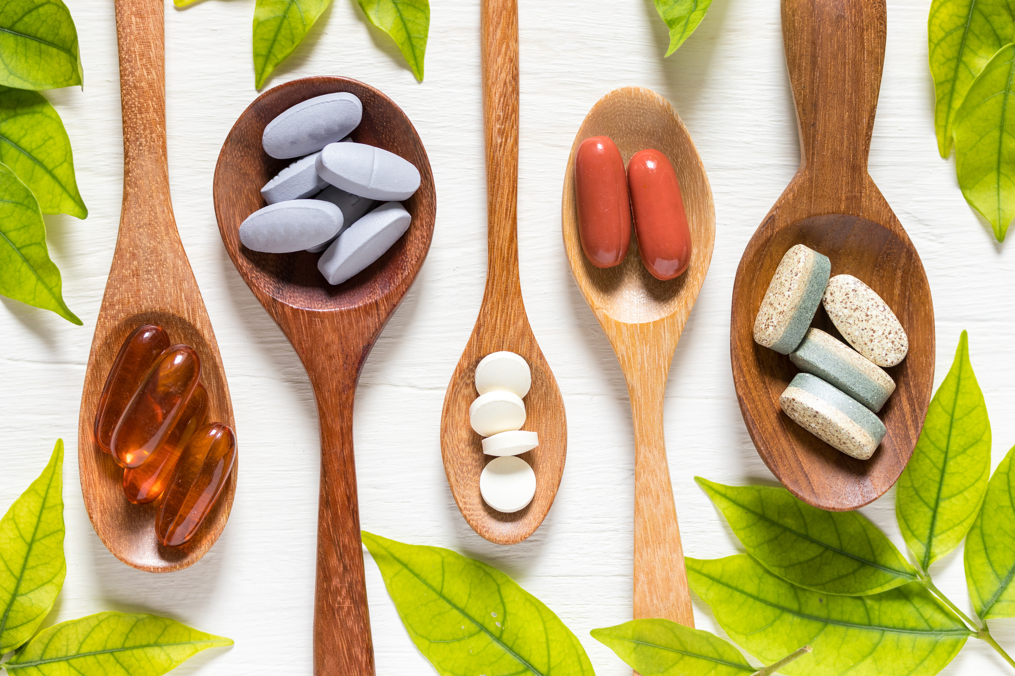
THE PROBLEM
1 BILLION people take supplements and believe they’re working.
Zinzino is a solutions-based company, solving a massive existing problem.
How many people know they’re working?
NONE
Notes:
If you’ve ever felt overwhelmed by wellness—
You're not alone.
There’s a supplement for everything.
Gut health. Brain health. Energy. Sleep. Mood.
But there’s one thing missing:
PROOF.
And that’s the problem.
We’re buying products without knowing what our bodies actually need.
No baseline. No tracking. No idea if anything’s working.
Zinzino came in to fix that.
We introduced an entire system of test-based nutrition—
where you don’t just hope it’s working…
You know.

Slide 5

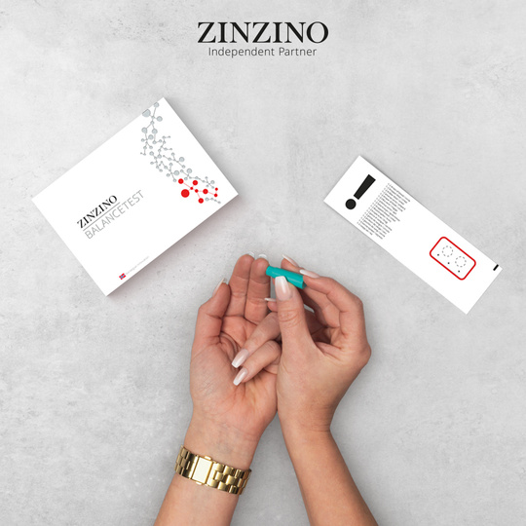
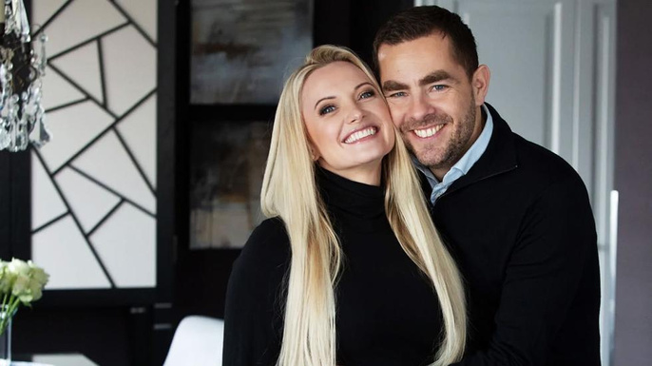

COMPANY OVERVIEW
141%
REVENUE INCREASE SINCE 2020
Founded in Scandinavia in 2005
Publicly traded on NASDAQ
Billion-dollar valuation by 2028
$205
MILLION IN REVENUE (USD, 2024)
AAA+
100+
RATING
WORLDWIDE MARKETS
PIONEERS OF TEST-BASED NUTRITION
ORJAN AND HILDE SAELE, FOUNDERS AND FIELD LEADERS
BUSINESS FOR HOME REVIEW
Notes:
Before we dive into the problem we are solving, and how we are doing it, here’s a quick lay of the land.
Zinzino is a personalized wellness company founded in Scandinavia in 2005 by Ørjan and Hilde Saele—legendary leaders who built seven-figure businesses before launching this company. And they’re still building alongside us today.
It’s led by people who’ve walked the walk—and still are.
And the growth backs it up:
141% revenue jump since 2020
$205 million in sales last year
Operating in 100+ countries
On track for a billion-dollar valuation by 2028
And yes—you can trust it.
AAA+ rated by Business for Home. That can’t be bought. It’s earned.
And here in the U.S.? We’re just getting started.

Slide 6

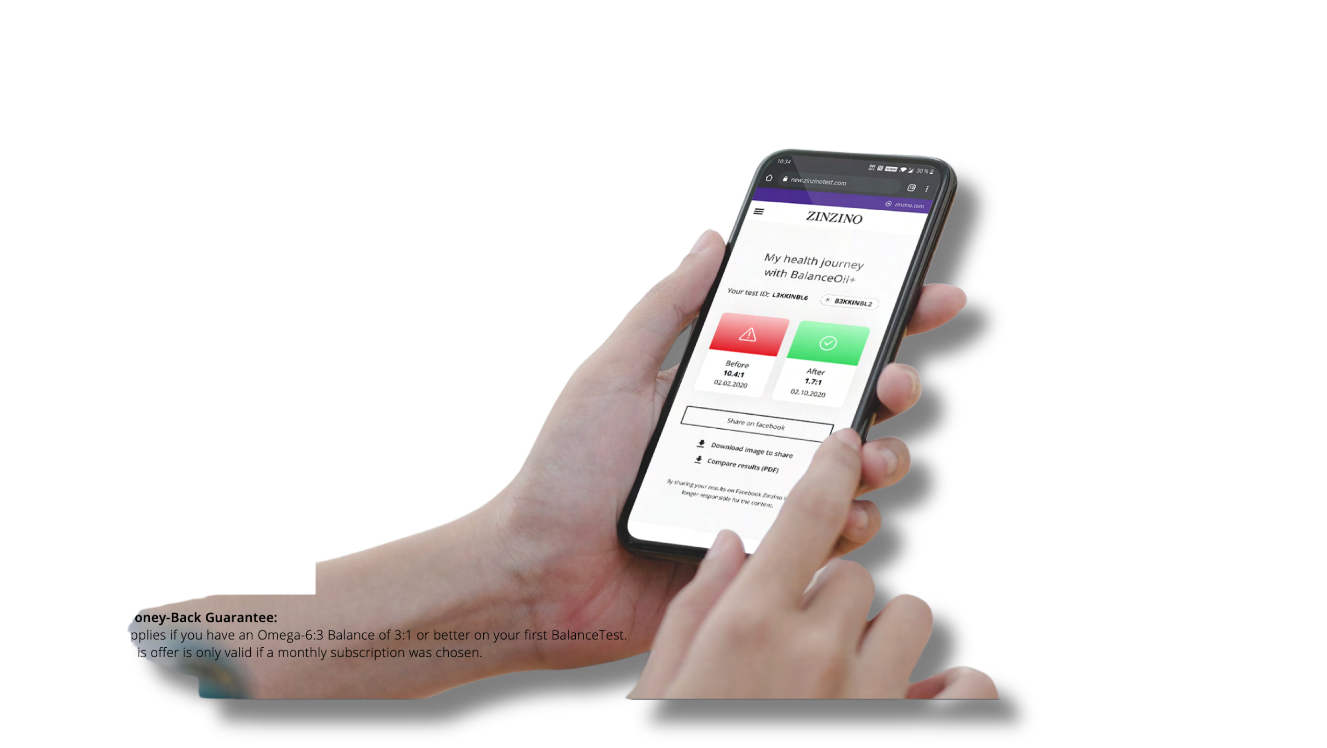
THE SOLUTION
TEST, DON’T GUESS
HOPE
BELIEF
KNOWING
Notes:
What you just saw isn’t theory. It’s what we’re doing—every day.
We’re helping people stop guessing and start measuring.
That shift—from hope to belief to knowing—it does something bigger than we realize.
It changes how people engage with their health.
And when that starts happening at scale?
It opens the door to something much bigger than individual wellness: It becomes collective.

Slide 7


OUR MISSION
Inspire change in life, by improving the health of our customers, and the financial well-being of our brand partners.
Notes:
Our mission is bold: We want to Inspire change in life, by improving the health of our customers, and the financial well-being of our brand partners.
And we’re doing it—by replacing guesswork with data, and equipping everyday people to create meaningful income.
Because when people feel better and earn better, they live better.
That’s a ripple effect. And it scales.

Slide 8
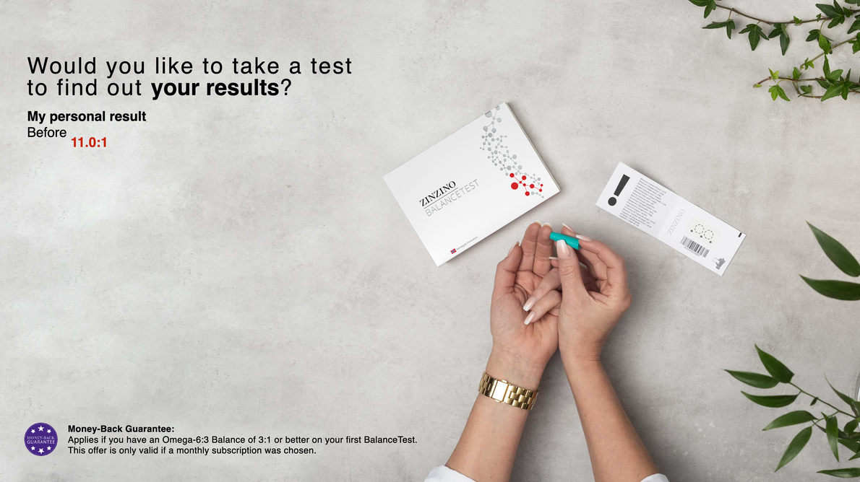
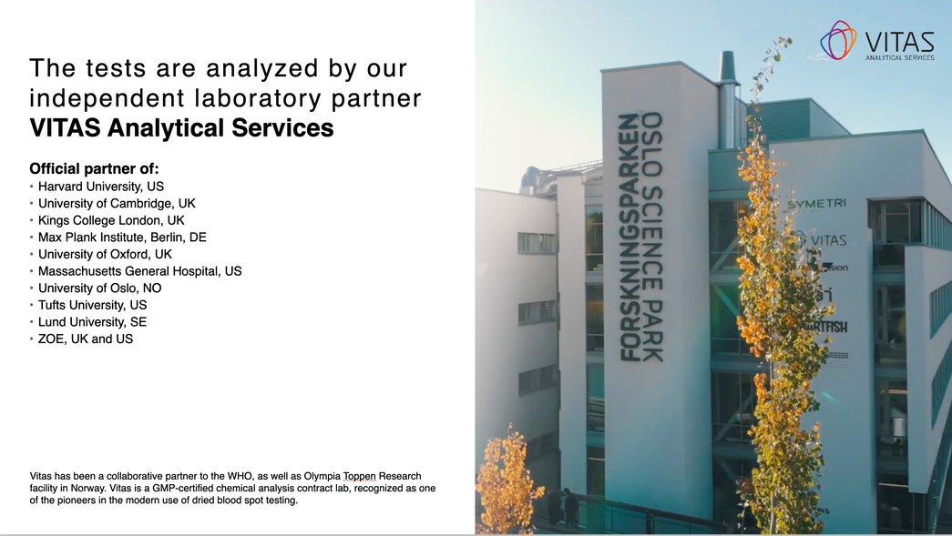
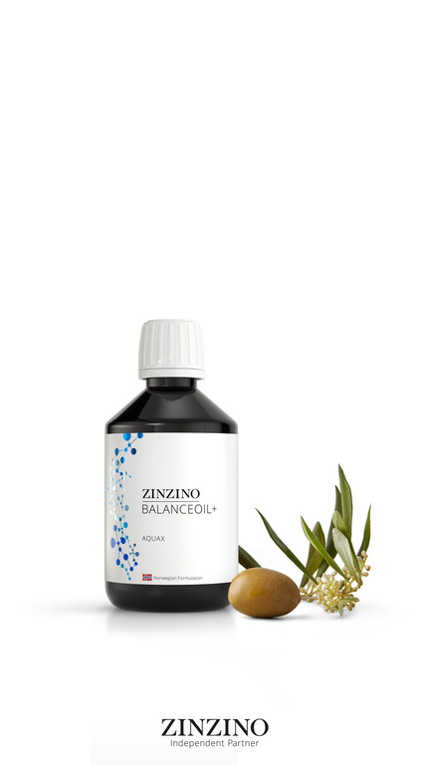
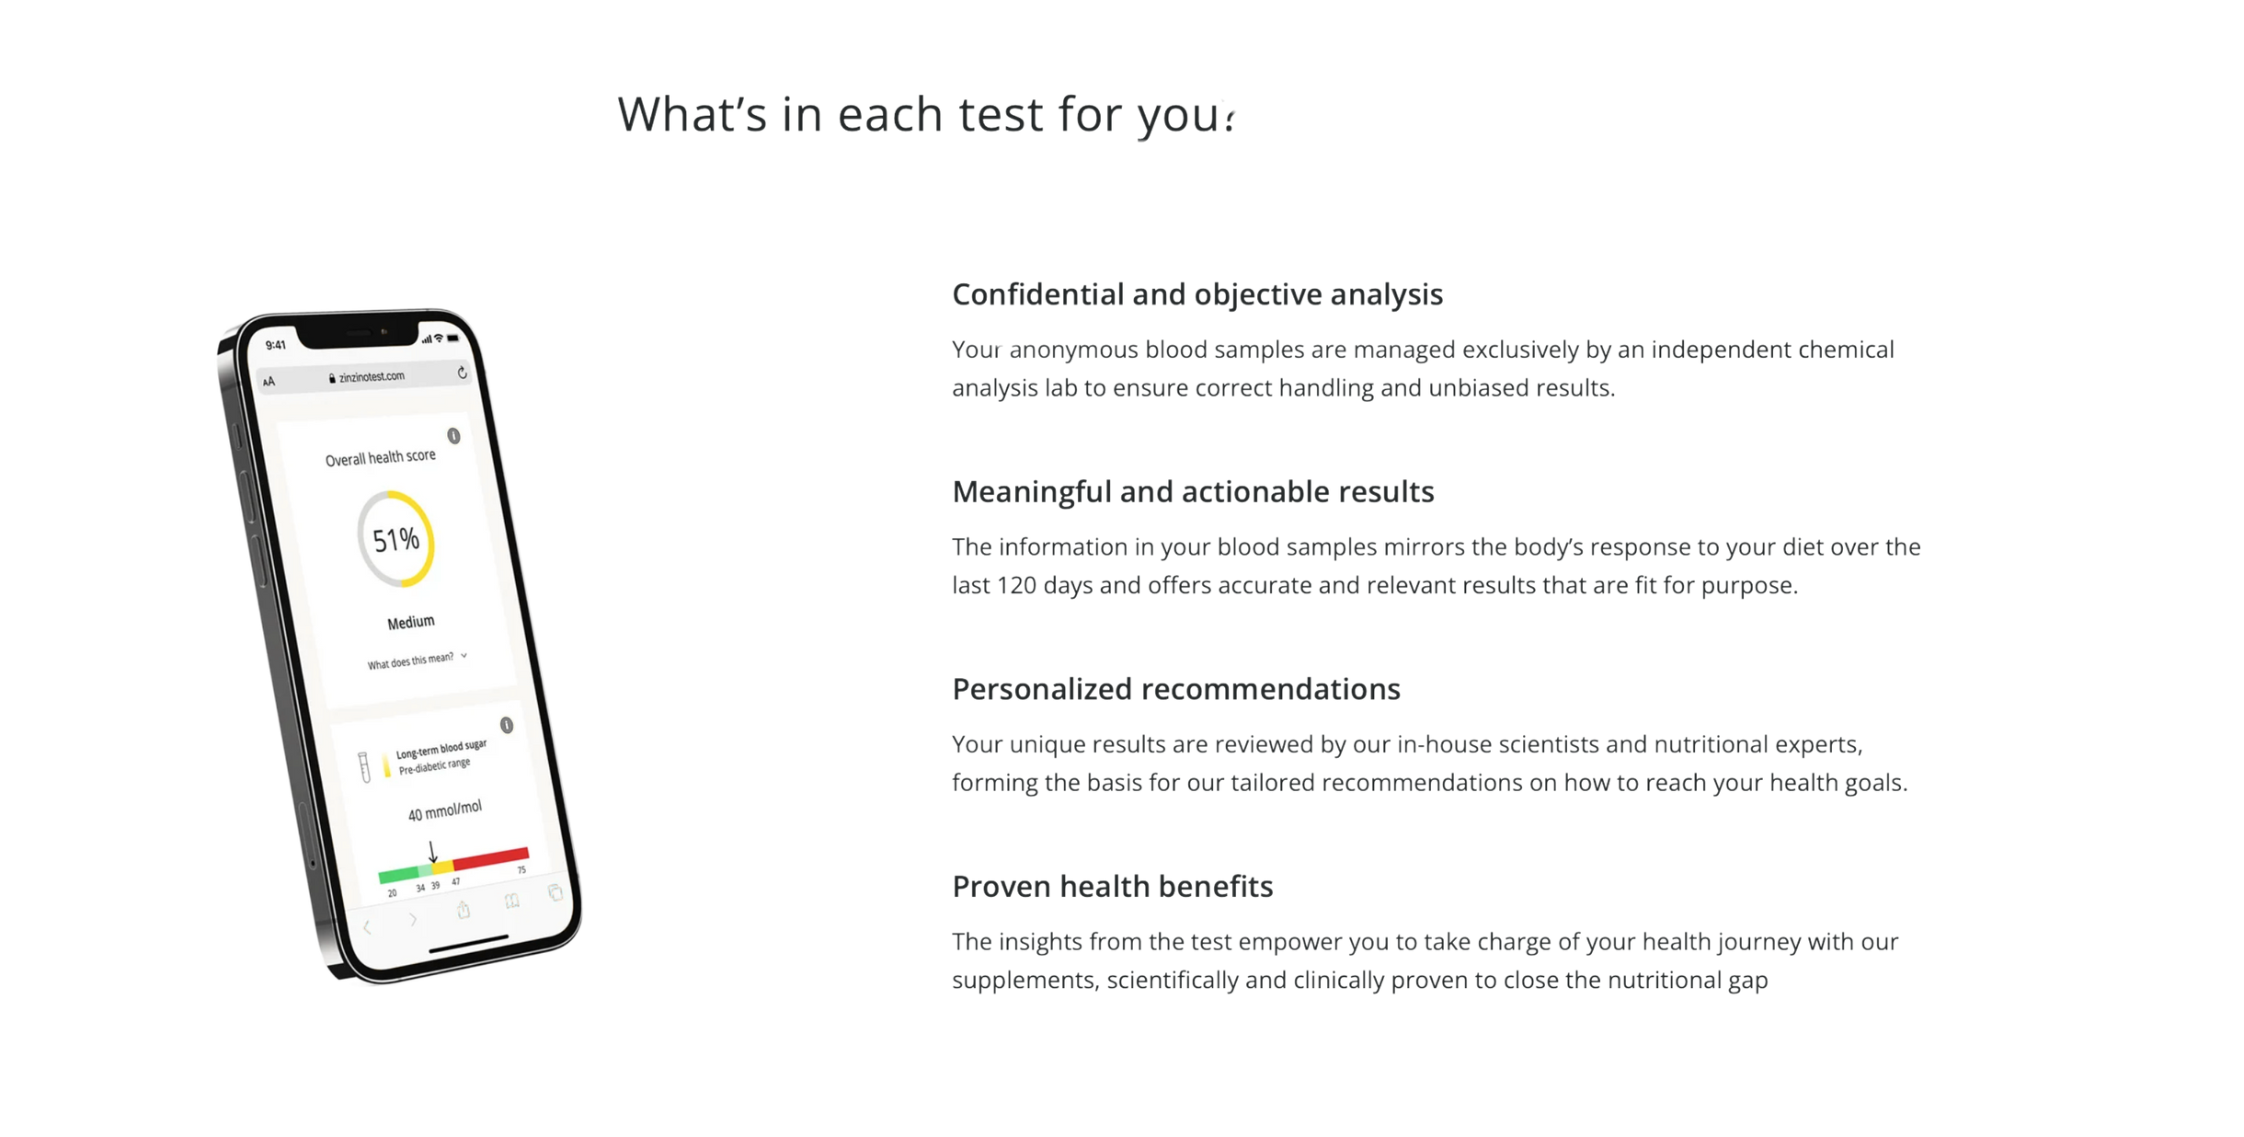
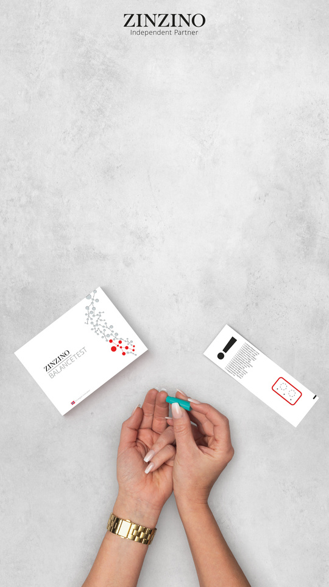
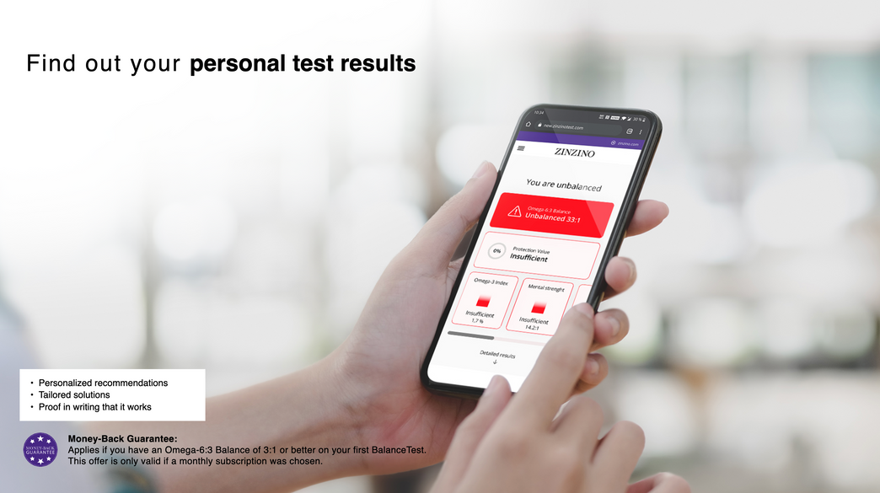
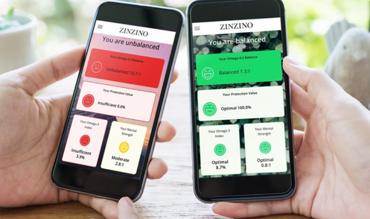
TESTING AND PROOF
The Customer Experience
Take a dried blood spot test at home
Send test to Vitas Lab in Norway for anonymous analyzation
Begin your supplement regimen
Continue taking your supplements for 120 days
10-15 days after testing, you’ll receive your results so you can see your baseline
Retest to see the measurable improvement in your health
Notes:
Here's how that ripple gets started. One person, one test at a time.
It begins with a simple at-home finger prick—just two drops of blood.
Each test is registered to a private, anonymous code.
(click)
That sample is mailed to Vitas Analytical Services in Oslo, Norway.
They’re the global leaders in dried blood spot analysis, and they're entirely third party. No affiliation to Zinzino.
(click)
While your results are processing, you’ll begin your personalized supplement routine.
No guesswork—just targeted support based on science.
(click)
About 15 to 20 days later, you’ll use your private code to access your results online.
You’ll see exactly where your baseline is—clear, measurable data that’s easy to understand and act on.
(click)
Then, after 120 days on the protocol, you retest.
Not to see IF it worked—but to see HOW WELL it worked.
So let’s talk about what we’re actually testing for—
and why it matters more than most people realize.

Slide 9
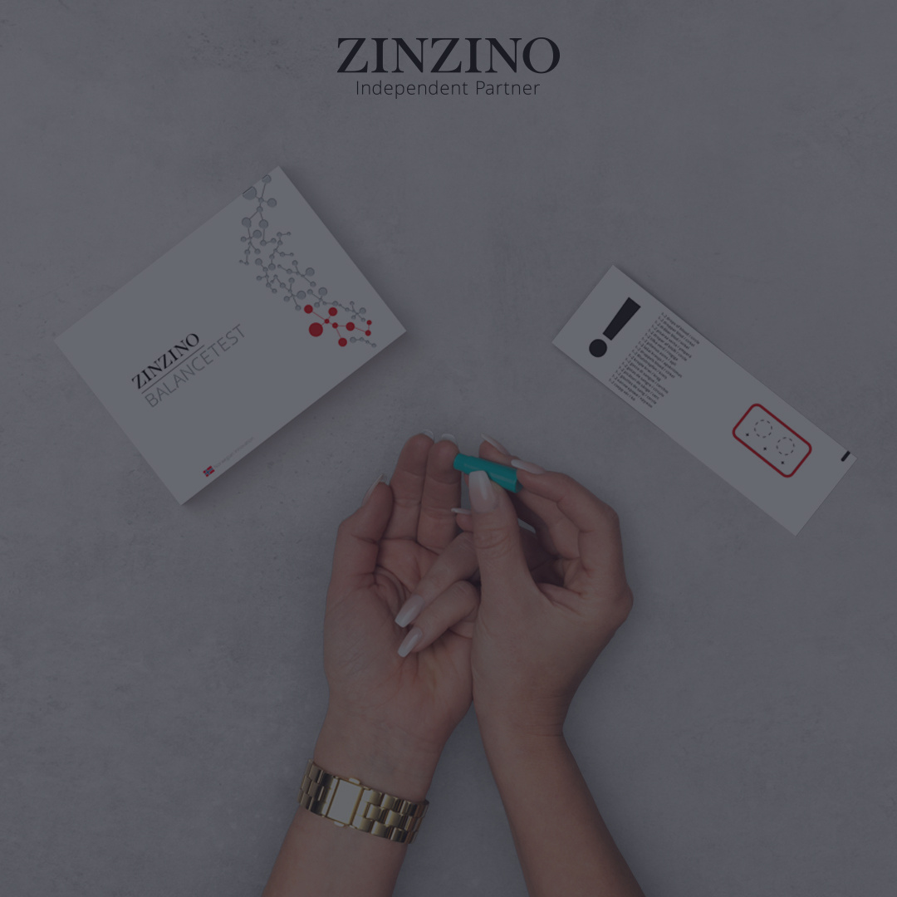
THE SOLUTION
Imagine if you could offer a test every person in the world needs, before they knew they needed it.
Notes:
At Zinzino, we offer three health tests today—with two more on the way.
But if I could put just one in the hands of every person on the planet, it would be this:
The Balance Test.
It measures your Omega-6 to Omega-3 ratio—
One of the clearest indicators of chronic inflammation in the body. And chronic inflammation is a silent driver behind so many health issues.
But here's the thing: Most people have never heard of the Omega Balance ratio.
But I believe this will be one of the next major biomarkers—right up there with blood pressure and cholesterol.
Because this test lets you catch the problem before the symptoms.
Before the diagnosis.
Before it spirals.
Let’s look at the science.

Slide 10
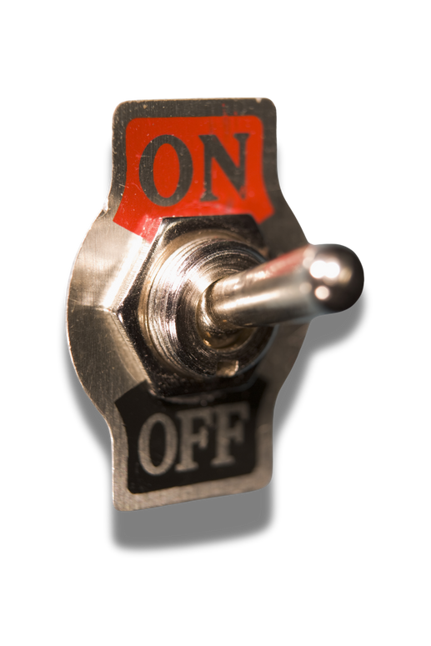


THE SCIENCE
The Hidden Health Crisis
OMEGA-6
OMEGA-3
Essential
Essential
Your body doesn’t produce it.
Your body doesn’t produce it.
Largly Pro-inflammatory
Largly Anti-inflammatory
Notes:
SO Let’s talk about these
Essential fatty acids.
Specifically: Omega-3 and Omega-6.
THEY'RE BOTH ESSENTIAL NUTRIENTS. Your body can’t produce them.
You have to get them through food or supplements.
And they're both directly tied to inflammation.
Omega-6 activates inflammation when needed. It fliups the switch in your cells.
CLICK
That’s not a bad thing—it’s how the body responds to damage or stress.
But that switch isn’t meant to stay on.
Omega-3 flips it back. It REDUCES inflammation.
It tells the cell: “We’re safe now. You can stand down. Let’s begin healing.”
The problem?
Most people today are getting flooded with Omega-6 and almost no Omega-3.
So the switch stays on.
And the cell stays in defense mode—low-level, chronic inflammation that quietly chips away at your health.
Until symptoms show up... long after the damage began.

Slide 11
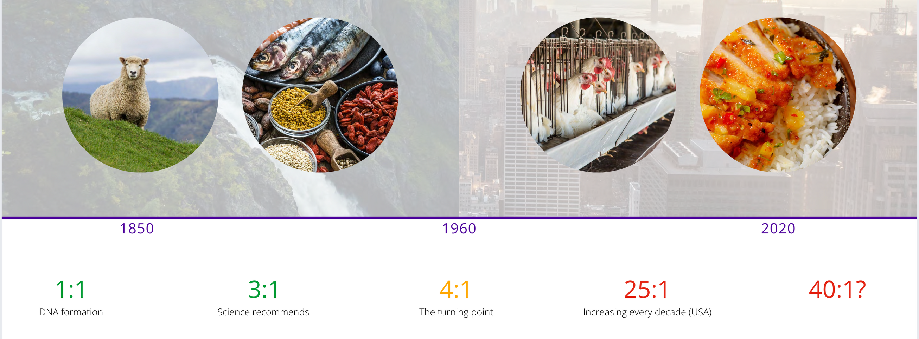
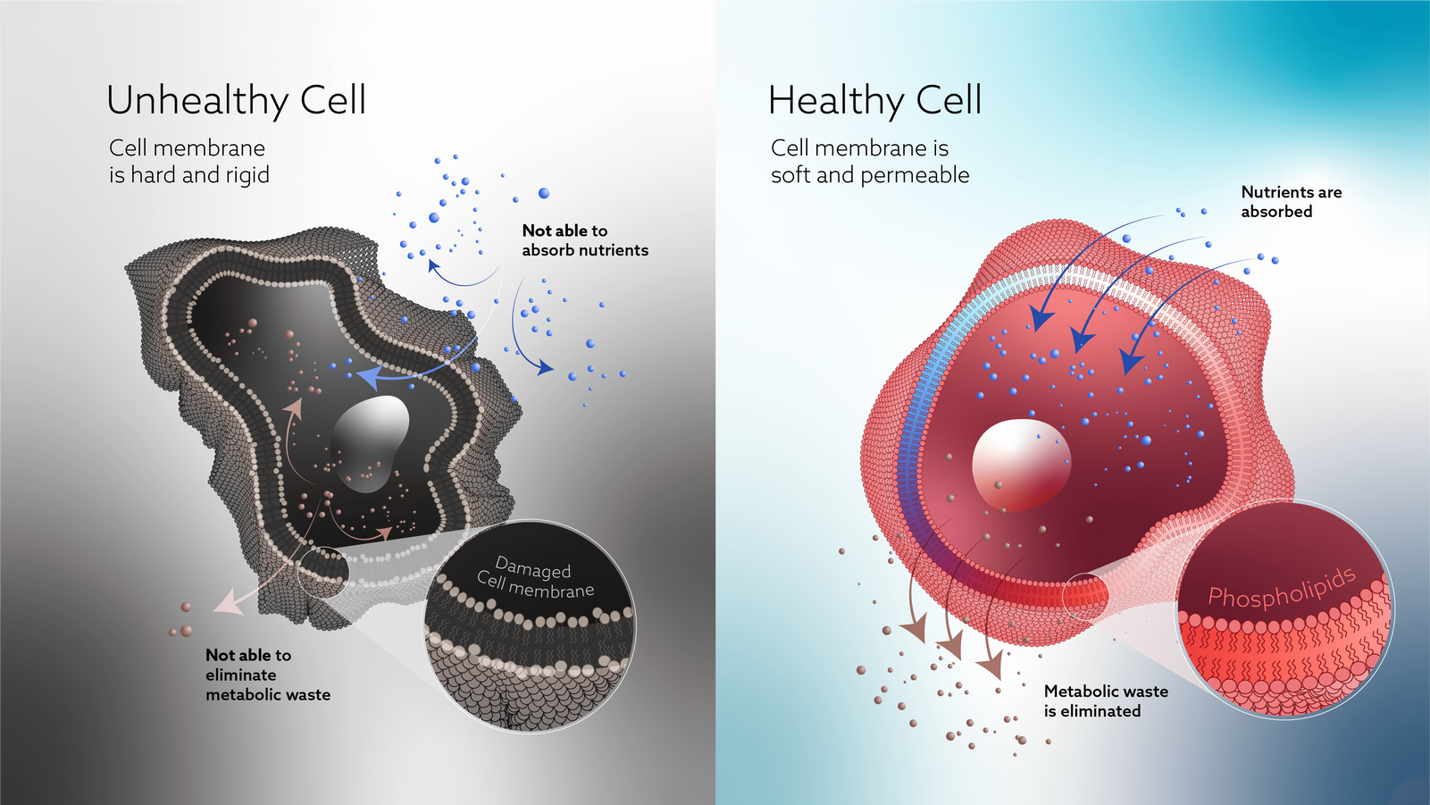
The Most Important Number
1:1
3:1
4:1
25:1
40:1
DNA Formation
Science Recommends
Turning Point
TODAY
?
3:1
is ideal
25:1
is average
Source: Vitas Analytical Services, Oslo, Norway – Analysis of over one million dried blood spot tests (Zinzino BalanceTest Data)
Notes:
So what’s the ideal balance?
Science shows that our bodies function best at around a 3:1 ratio—Omega-6 to Omega-3.
That’s the level our ancestors maintained for thousands of years.
(click)
At 3:1, your cell walls are soft and permeable.
Nutrients get in. Waste gets out. The body works the way it’s supposed to.
But today?
(click)
Today, the average person is walking around with a ratio of 25:1 or higher.
That’s not just a little off—that’s a completely different environment inside the body.
(click)
So what happened?
It started in the 1960s—when industrial farming, processed foods, and cheap seed oils flooded our food supply.
Omega-6 became the dominant fat. Omega-3 all but disappeared.
(click)
And when there’s too much Omega-6?
Cell walls get stiff. Nutrients struggle to enter. Toxins can’t escape.
The body stays in defense mode. Inflammation builds—slowly, quietly—until symptoms finally surface.
Now here’s the big question:
How many people are walking around like this—and have no idea?
Let’s take a look.

Slide 12

THE DATA
MIDDLE EAST
100% should take the test
NORTH AMERICA
EUROPE
98%
99%
AFRICA
95%
99%
97% fail the test globally
98%
ASIA
99% fail the test in the USA
97%
SOUTH AMERICA
Notes:
Zinzino has now run over one million Omega Balance Tests around the world.
And here’s what we found:
97% of people are out of balance.
In the U.S., it’s even higher—99%.
Now here’s the part that really matters:
These numbers include people who were already taking Omega-3s.
People eating clean. People doing “all the right things.”
They were still failing the test.
And that was a moment of truth for me.
Because if the Omega-3 I was already using actually worked—
Shouldn’t my test have shown that?
It didn’t.
So maybe the issue isn’t just about taking Omega-3—
Maybe it’s about taking the right kind.
And that’s exactly what we’re going to unpack next.

Slide 13

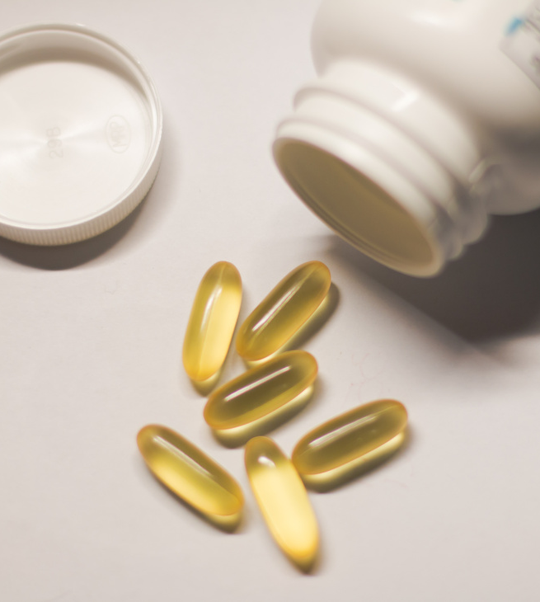

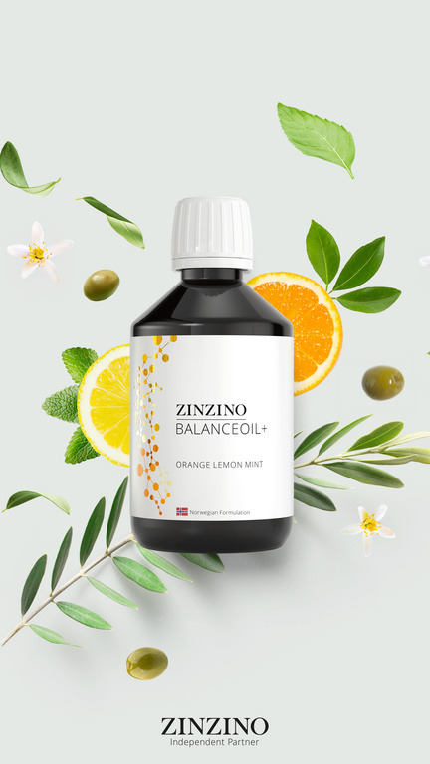
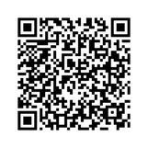
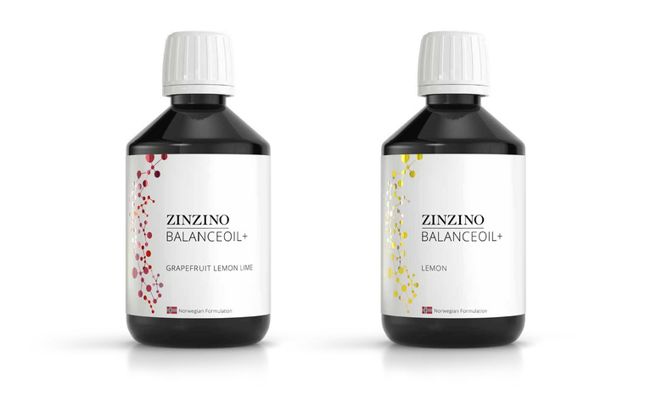
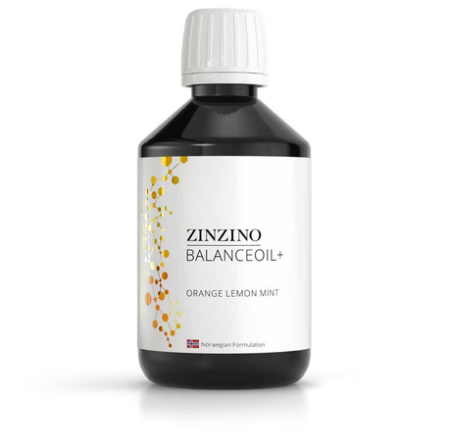
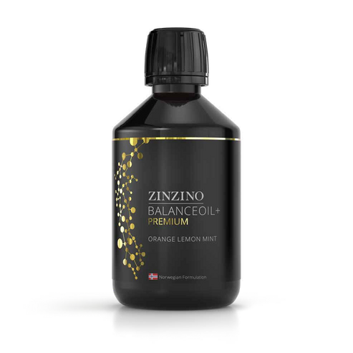
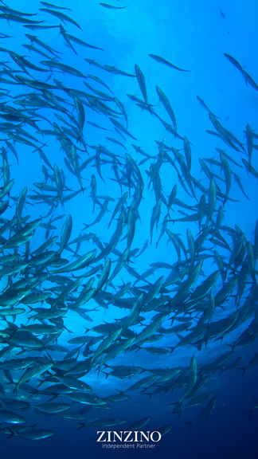
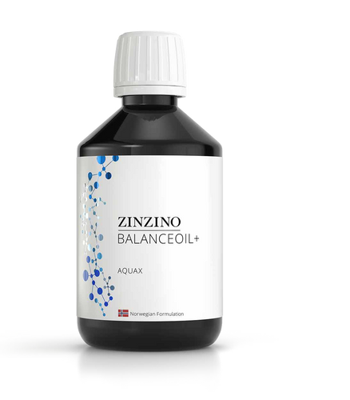
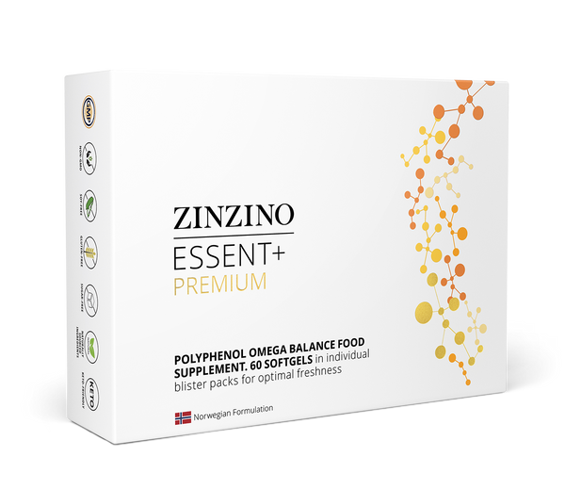


Balance Oil+
The Innovation Behind the Results
TRADITIONAL FISH OIL
BALANCE OIL
VIDEO: WHAT MAKES BALANCE OIL DIFFERENT
60% WILD-CAUGHT FISH
60%
Ultra-purified, sustainably sourced fish oil is free of toxins and contaminants
NO POLYPHENOLS
Low Absorption
High levels of oxidation
Lower potency
Short shelf life
Improperly purified
Generic dosing
We Have Revolutionized the Fish Oil Industry
40% PRE-HARVEST OLIVES
40%
Pre-harvest olive polyphenols restore the antioxidants lost in fish oil refining
Omega-3
EPA
DHA
DPA
Omega-7 700 mg
PER 12 ML
2500 mg
PER 12 ML
1300 mg
PER 12 ML
700 mg
PER 12 ML
150 mg
PER 12 ML
Notes:
So let’s talk about what actually DOES work.
Remember how Dr. Colin Robertson told us the research showed most Omega-3s aren’t making it into the cells?
Let me show you WHY. It all comes down to one word: POLYPHENOLS.
(click)
During the fish oil refining process, polyphenols—the natural antioxidants that protect Omega-3s—are stripped away.
Without them, the oil becomes unstable.
It oxidizes. It breaks down. And the body can’t absorb it properly.
THAT'S why people taking “good” Omega-3s were still failing their test.
Zinzino found a way to ADD THE POPYPHENOLS back IN.
CLICK
After years of research, they discovered a rare olive harvested just before ripening—packed with the same polyphenols fish oil needs to stay protected.
CLICK
So they combined 60% wild-caught, ultra-purified fish oil
with 40% pre-harvest olive oil rich in polyphenols.
The result?
Omega-3s that stay stable, absorb properly, and actually reach your cells—just like nature intended.
And most importantly?
Proven to restore balance.
BalanceOil+ is the only Omega-3 supplement in the world with clinical results showing it actually works—measured by a before-and-after blood test.
That’s not marketing. That’s science.

Slide 14
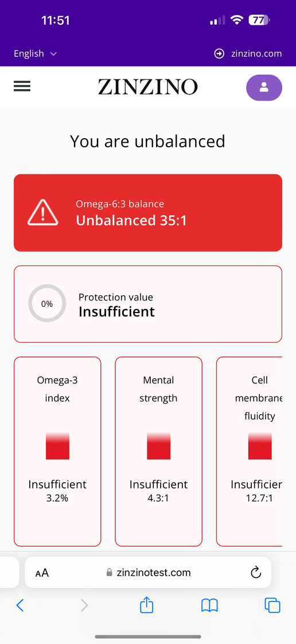
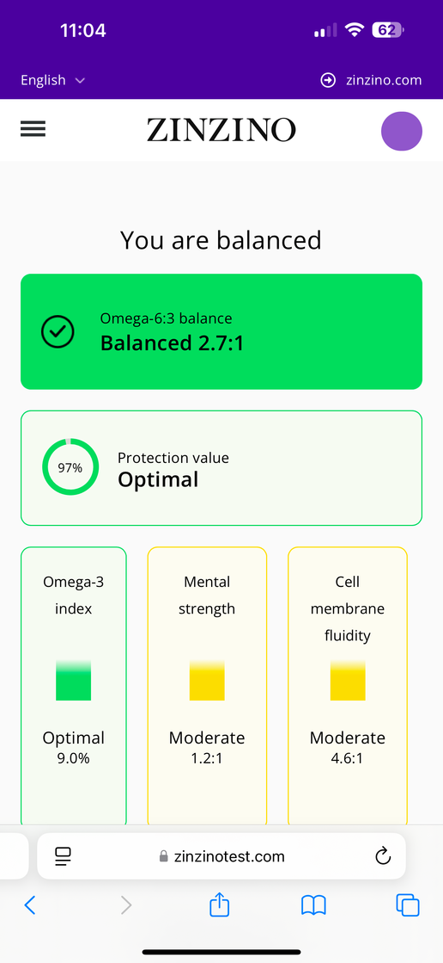
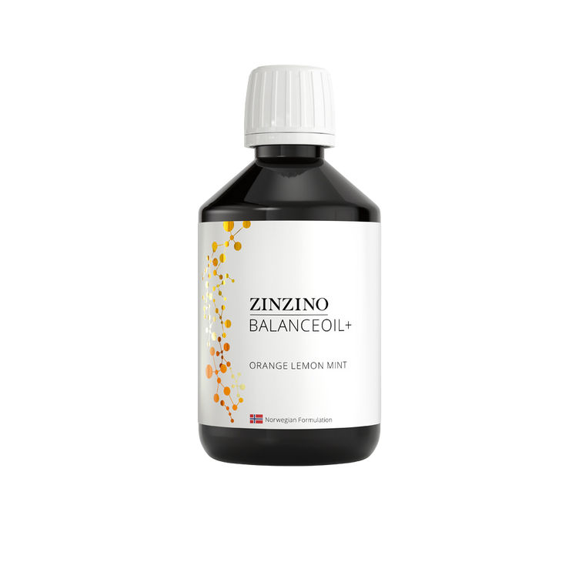

Results in 120 Days
START
120 days
Notes:
So what does the proof actually look like in the client experience?
Let me show you.
Now technically, you’re only supposed to test every 120 days.
But I’m curious—so I tested every 30.
I wanted to see what was really happening in my body.
Not just how I felt—but what the data showed.
And each time, I got a full, comprehensive report.
Not just a score, but a breakdown of what was improving and what still needed work.
✔ At the start, I was way out of balance.
✔ At 30 days—still out of balance, but things were shifting.
✔ By 60 days, I was climbing into the semi-balanced range.
✔ And by 90 days—I was almost at that ideal 3:1 ratio.
And then by 120 days? I felt it.
✔ I was sleeping better.
✔ My focus was sharper.
✔ My joint pain had eased.
✔ I just felt clearer.
The number told the story. But so did my body.
And here’s the thing—I’m not the only one.

Slide 15
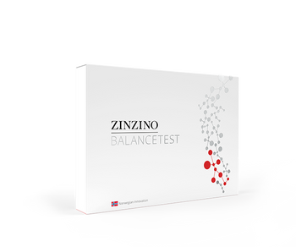
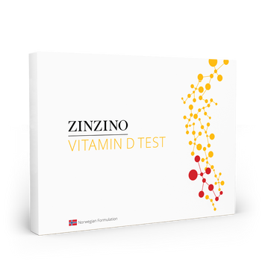
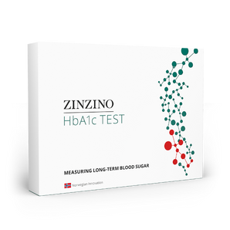
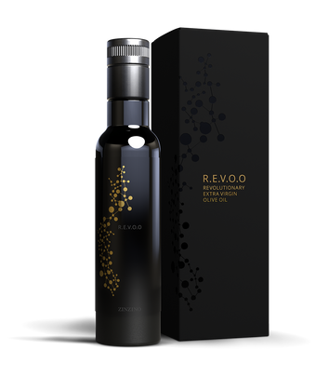
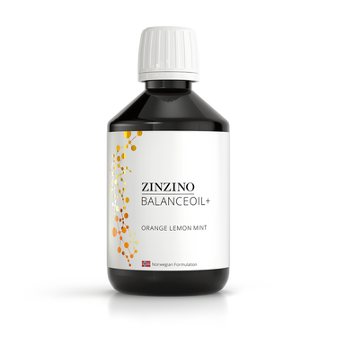
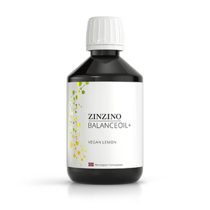
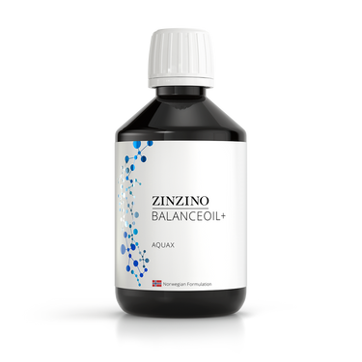
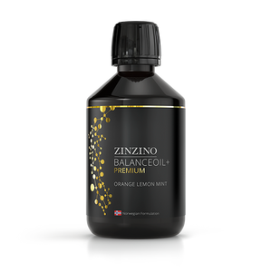


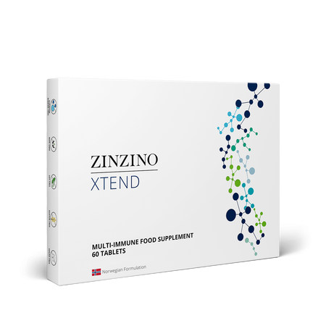
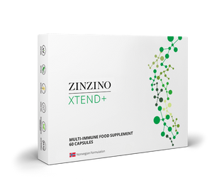
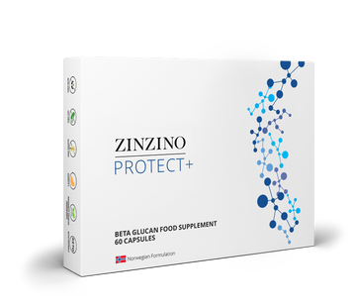
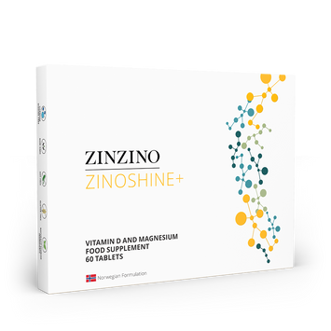
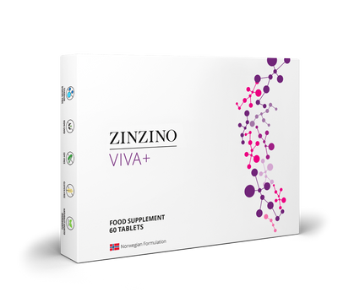










Our Complete
Product Portfolio
Dry blood testing
BalanceTest
Vitamin D Test
HbA1c Test
Balance supplements
BalanceOil+
BalanceOil+ Vegan
BalanceOil+ AquaX
BalanceOil+ Premium
Essent+ Premium
R.E.V.O.O
Immune and restore
supplements
Xtend
Xtend+
Protect+
ZinoShine+
Viva+
ZinoGene+
Multify
Gut health and
other wellness products
ZinoBiotic+
LeanShake
Energy Bar
Collagen Boozt
Skin Serum
Hanzz+Heidii
Notes:
Zinzino isn’t just about BalanceOil.
We’ve built an entire system—starting with three dried blood spot tests:
✔ Omega Balance
✔ Vitamin D
✔ HbA1c for long-term blood sugar
From there, we match each person with targeted support:
✔ Immunity
✔ Gut health
✔ Brain function—like Viva
✔ And skin health with CollagenBoozt and Skin Serum

Slide 16


Timing Right?
Is the
Right?
Notes:
We’ve just walked through the biggest piece of the puzzle:
The problem, the science, and the solution.
That’s the foundation.
So now I want to turn your attention to something just as critical:
Timing.
Because being early? That changes everything.

Slide 17







Why This Creates
Massive Opportunity
Notes:
The research about Omega balance and its links to inflammation has been out for years.
But the public? They’re just now starting to notice.
It’s starting to show up in headlines, podcasts—some doctors are beginning to talk.
And that’s what makes this moment so powerful
Zinzino isn’t following the trend.
We’re leading it.
We’re already testing, educating, and delivering results.
And when this goes mainstream—because it will—
Zinzino will be miles ahead.
Let's hear from Dr. Colin Robertson for a moment, as he shares how we are always looking to the future in terms of trend and innovation.

Slide 18

IS THE TIMING RIGHT?
Ahead of the curve
PRE-TREND
TREND
Sweden
Norway
Finland
Denmark
Iceland
Estonia
Latvia
Lithuania
1.5%
2.5%
The United States:
5 Million Tests
(1 Billion in Sales)
8.2 Million Tests
54,451+ tests to date
Notes:
H
What you just heard from Colin—that’s not theory. That’s where we’re going.
And this is why NOW matters.
When you combine a one-of-a-kind solution with perfect timing,
you create something big: an early adopter opportunity.
And if you’ve watched any major wellness trend take off—
Oura Rings, fasting, cold plunges—
you know the power of catching it early. They were TRENDS that became mainstream.
Right now, test-based nutrition is at that same tipping point.
(click)
To officially qualify as a trend, just 2.5% of the population has to be aware of it.
(click)
Zinzino’s main markets? We’re at 1.5%.
(click)
In the U.S., we’ve barely scratched the surface—just 45,000 tests.
(click)
To hit 1.5% here, we’d need over 5 million test. That’s $1B in revenue.
(click)
8.2 million gets us to official “trend” status.
So yes—this is early.
We’re testing for the next big biomarker before most people even know it exists.
And the ones who recognize it now? They get to lead it.

Slide 19
Company Solid?
Is the
Right?
Notes:
H
Now let’s move to the third question—
Is the company solid?
Because opportunity is only as good as the engine behind it.
You want to know—
Is this a stable company with staying power?
Is the model working?
Is demand growing?
Let’s take a look at the trajectory… and the numbers behind it.

Slide 20


IS THE COMPANY SOLID?
Trajectory
The
An Established Company,
Positioned to Win
The foundation is set.
The model is working.
The demand is rising.
Notes:
When I looked at Zinzino, I wasn’t looking for hype. I didn't want to be part of a startup or a trend.
I was looking for infrastructure, scalability, and timing.
And what I found was rare: a publicly traded company that already built the system most brands are still trying to figure out.
And then I saw this growth curve.
This is momentum—33% average growth per year, over 60% last year.
But what makes this so powerful isn’t just the numbers—
It’s WHERE WE ARE on the curve.
We’re still early. But not unproven.
And from here? It scales. Fast.
1 million customers now.
20 million by 2035.
100 million by 2050.
If you’ve ever said, “I wish I had gotten in earlier…”
This is earlier.
And this time, you know what you’re looking at.

Slide 21
Win here?
Can I
Right?
Notes:
Which leads us to our last question: Can I win here?
Does this actually pay?
Yes. Let's talk about how.

Slide 22







CAN I WIN HERE?
Earning Potential
10 - 30% on New Customer Orders
More Customers = Higher Percentage
TWO PATHS TO RESIDUAL INCOME:
Monthly Customer Bonuses
CUSTOMER PLAN
PARTNER PLAN
25
50
100
200
Earn by selling products to customers / patients through your online store.
Start building a team of distributors, and earn overrides on their businesses.
$115
$230
$460
$1150
+ one time $11,500 bonus
Features
+ luxury trip
Notes:
There are two ways to earn with Zinzino:
The Customer Plan and The Partner Plan. You don't choose one or another. You can tap into BOTH.
Let’s start with the Customer Plan—because if you just want to share products and earn from customer orders, here’s exactly how it works:
You get a free online store, ready to use.
You earn 10 to 30% on customer orders—
And the more customers you serve, the higher your payout.
But it gets better:
There are monthly customer bonuses as your base grows.
And when you reach 100 customers, you earn a one-time $11,500 bonus on top of your monthly pay.
For some people, that’s exactly what they’re looking for—
Simple, sustainable income by helping people get healthier.
But for others?
Those who want to build a team, grow something big, and unlock serious scalability?
That’s where the Partner Plan comes in.
Let’s take a look at that next.

Slide 23

CAN I WIN HERE?
CAN I WIN HERE?
Earning Potential
TWO PATHS TO RESIDUAL INCOME:
CUSTOMER PLAN
PARTNER PLAN
Earn by selling products to customers through your online store.
Start building a team of distributors, and earn overrides on their businesses.
Notes:
Now let me paint the bigger picture.
You start just like before—sharing products through your free online store.
(click)
But then you introduce a few people who want to do the same.
They become partners. They start building their customer base. Their own momentum.
(click)
Then they bring in a few more partners.
(click)
And now you’ve got something bigger than effort—
you’ve got duplication.
You’re not just earning on what you do—
you’re earning on what duplicates.
And that’s where the power is.
Because Zinzino uses a binary compensation plan,
you override it all. That volume?
It flows up through your structure—
and you’re paid weekly. Like clockwork.
There’s no other industry I know that lets you compress a 30-year career into five.
That’s the power of leveraged income.
And once it starts to build, it gets exciting—fast.

Slide 24











CAN I WIN HERE?
Earning Potential
TEAM COMMISSION
Earn 10-15 % on your network of online stores
PARTNER PLAN
TITLE BONUSES
Earn up to 3 Bonuses per title ($150 - $120,000)
LUCRATIVE EXTRAS, EARNED WITH RANK:
$230 / month phone bonus
$1150 / month car bonus
Luxury vacations
Shares of Zinzino Stock for achieving President and above
CUSTOMER ACQUISITION BONUS
Help partners get customers.
They earn, you earn.
MENTOR MATCHING BONUS
5-25% matching income bonus
VOLUME COMMISSION
1–4% of weekly volume bonus
Notes:
So what does earning look like when you build a team?
As a partner, you unlock multiple income streams that grow as your organization grows.
The biggest one?
You earn 10 to 15% in weekly commissions on the total volume from your entire team’s online stores.
And as your business expands, so do the rewards.
You can earn one-time title bonuses—some as high as $120,000.
And along the way, you pick up weekly customer growth bonuses,
mentor matching income on what your personally enrolled partners earn,
and even volume commissions on your total team sales once you reach Director and above.
But it doesn’t stop there.
Zinzino adds in fun extras like a monthly phone bonus,
a $1,150/month car bonus,
luxury incentive trips,
and even company stock when you reach the top ranks.
This is where leveraged income meets real lifestyle reward.
It’s designed to scale—and built to last.

Slide 25

In the life of a customer, no company even comes close to what Zinzino is doing.
In the life of a partner, there is no one who gets a home like the one they get in Zinzino.
Notes:
J
Final Thought: This Is It
Eleven years ago, I sat in a presentation like this—wondering if I should take the leap.
I said yes.
And it changed everything.
That decision opened doors I didn’t even know were closed.
It was one of the best decisions of my life.
And now—here we are again.
But this time, it’s even bigger.
Because no one else is doing what Zinzino is doing.
And what I’m going to build here—what we’re going to build—
is the legacy play.
So if something in you is saying “maybe”—
Open the door.
What’s the worst that could happen? Let's move the dial on global health TOGETHER.

Slide 26

Getting
Started
Notes:
If you’re feeling that pull—the “this might be for me” nudge—
Let me show you how simple it is to get started.
You don’t need to know everything.
You just need to take the first step.
Let me show you exactly how it works.

Slide 27



Select a Partner Kit
Notes:
The first step is choosing a Partner Kit.
We’ve got three main options—and each one gives you the core products, tools, and support you need to start strong.
But if I can be honest with you?
There’s one kit I recommend every time—and that’s the Ultimate Partner Kit.
Here’s why:
It gives you a full experience—not just a few products to sample, but a chance to actually use Zinzino in your home, with your family, and feel what we’re talking about.
Most importantly?
It comes with 10 Balance Tests.
Those tests are normally $179 each in the U.S.—so the value alone is a no-brainer. But more than that, those 10 tests become your most powerful business tool.
Because when someone sees their number… everything changes.
So if you're serious about this?
The Ultimate Kit isn’t just the best value.
It’s the smartest way to start. Especially with our current campaign.

Slide 28


Ultimate Partner Kit Refund Campaign
US$1,150
Retail price US$3,165
Get a full loyalty refund when acquiring 25 Premier Customers within a year of purchasing the Ultimate Partner Kit*
Get your money back:
Basic and Advanced Partner Kits can be upgraded during the first 6 months to get the refund.
* Read all the details in our Ultimate Partner Kit Refund Campaign sheet.
Notes:
And right now?
There’s something else that makes the Ultimate Kit an even easier yes.
Zinzino is running a refund campaign.
If you choose the Ultimate Kit and stay consistent—
By your twelfth month, if you have just 25 products going out to customers,
Zinzino will refund the entire cost of your starter kit.
Let me say that again:
You’ll get back 100% of what you paid to start your business.
That’s not just generous—it’s smart.
Because 25 customers over 12 months?
That’s just over two a month.
It’s not only doable—it’s designed to set you up for a long-term, sustainable business.
So when I say the Ultimate Kit is the smartest way to start?
This just sealed it.

Slide 29

Select Your Monthly Auto-Order
Includes
One Balance product of your choice every month
One Test every 4 months (one BalanceOil+ Premium in New York)
Powerful Back Office, easy-to-share landing pages
GoCore App, for personal and professional development
US$79 I Save 36% I 10 Credits
Retail price US$123
Follow the program: In 120 days you will be in Balance and have proven before and after test results.
Notes:
Next, you’ll activate your own online store by setting up a subscription with the Z4F Premiere Kit—this is your only real overhead, and it’s $79 a month. It incudes one bottle of Balance Oil a month, and access to your Back Office.
That one step makes you an active partner and eligible to earn commissions on your team.
And that’s it.
$79 a month.
That’s your total cost to run a business with global reach, proven products, and weekly payouts.
And if you've ever spoken to a brick and mortar business owner, they'll be the first to tell you that $79 a month is a steal.

Slide 30





Get Your Products for Free
Love it. Share it. Get free products
Subscribe to a Z4F Kit and share your product experience
Enroll 4 or more subscribing Customers with a Premier Kit*
Get your own monthly subscription (Auto Order) for free.
All you pay is shipping.
Customer
YOU
Z4F
4 Premier Customers
Get paid
Partner
YOU
Z4F and get paid
*The credit value of your first generation Customers’ combined purchases must be at least 40 Credits.
Notes:
And here’s the best part: This monthly $79 is free once you have four active personal customers. That means you’re earning and saving at the same time.

Slide 31







Fast Start Program Total Bonus $2875
SELL FOUR PRODUCTS ON SUBSCRIPTION
ENROLL 2 PARTNERS WITH AN ULTIMATE KIT
€ 100 BONUS
($115 USD)
€ 400 BONUS
($460 USD)
HELP THOSE TWO PEOPLE EACH ENROLL TWO PARTNERS
ADD 6 MORE PRODUCT SUBSCRIPTIONS (TOTAL OF 10)
€1200 BONUS
($1380 USD)
€150 BONUS
($172 USD)
Notes:
Let me show you how we set people up to win—right from the start.
Our Fast Start Program is a simple launch plan that gets you profitable quickly—with great bonuses on top of your regular earnings.
It’s focused. It’s achievable. And it builds momentum.
Step 1: (click)
Sell 4 product subscriptions.
Earn a $115 bonus and get your own monthly product for free.
Step 2: (click)
Enroll 2 business partners with Ultimate Kits.
Earn $460.
Step 3: (click)
Help those 2 do the same—this is where duplication kicks in.
You’ll earn $1380 and start building a real team.
Step 4:n (click)
Add 6 more customers to hit 10 total.
That’s another $172 bonus.
Altogether, that’s over $2,100 USD in EXTRA bonuses—just for following this simple roadmap.
It’s strategic. It’s proven.
And it shows you exactly what to do to get paid and promoted from day one.

Slide 32


Slide 33

Next Steps
✔ Become a Zinzino Partner – Lead the future of personalized nutrition and grow your impact.
✔ Schedule a Follow-Up – Let’s go over the details and find the best fit for you.
✔ Become a Zinzino Customer – Experience the benefits and get your health in balance.
✔ Connect Us With Others – Know someone who’d be interested? Introduce us—we’ll handle the rest.
Notes:
J
Let's bring it home: We started with four questions:
✔ Does it solve a real problem? Yes—and we proved it with science and results.
✔ Is the timing right? We're ahead of a global shift—still early, but not unproven.
✔ Is the company solid? Absolutely—publicly traded, fast-growing, and built to last.
✔ Can I win here? You can. Whether it’s free products or full-time income, there’s a path.
So now it’s your turn.
If you’re ready—we’ll walk with you.
If you’re curious—let’s talk more.
And if you’re passing—for now—we'd love to get you started on your health journey with our products.

