Slide 1
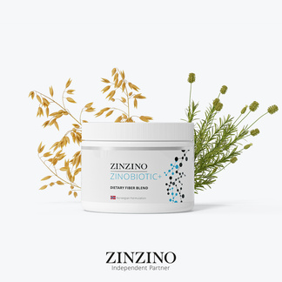

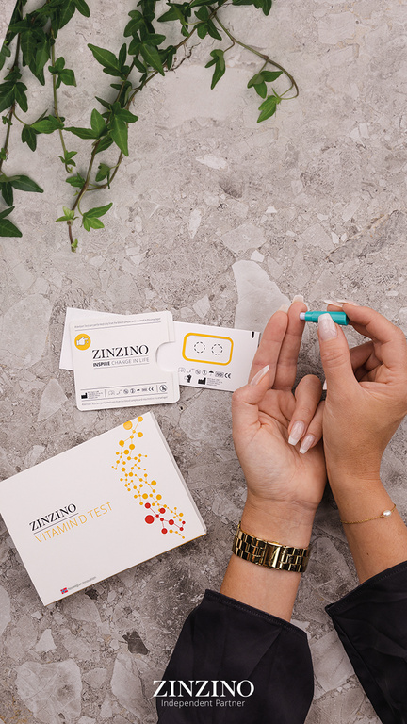
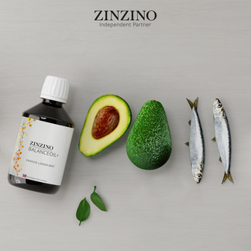
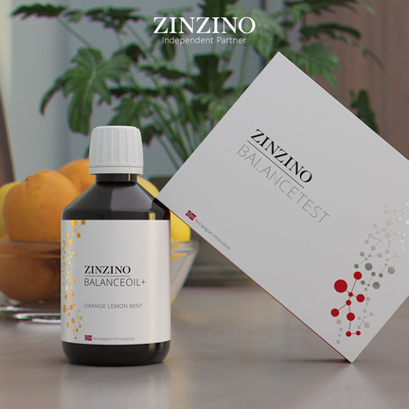

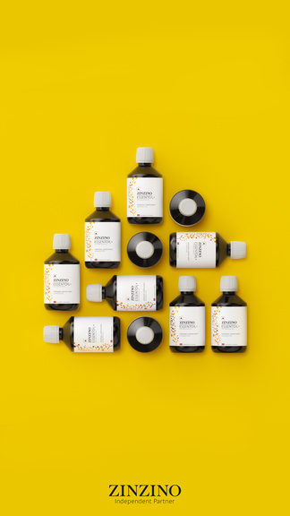


The Future of Personalized Health
Test-Based Nutrition & Zinzino
Notes:
Hi everyone—I’m Heather Nianouris, coming to you from my home office in Dayton, Ohio, and I’m really glad you’re here.
Let me give you some quick context.
I spent 12 years in social selling—helping everyday people build income by sharing products they love. I built a global team of over 10,000 and was one of the top leaders at my former company.
But last July, the rug got pulled out from under us. The company shifted directions overnight, and just like that… years of income disappeared.
It made us pause. Reevaluate.
My husband and I made a list—an actual list—of what it would take to start again. And honestly? The bar was high.
We weren’t looking for hype. We wanted substance.
Something testable, credible, and disruptive in all the right ways—something that would speak to both everyday people and professionals.
That’s when we found Zinzino.
This wasn’t just another supplement company—it was a whole new way of thinking about wellness.
And the deeper we got in, the more I realized…
I wasn’t starting over.
I was leveling up.
And that’s what I want to show you today:
✔ Who Zinzino is—and why you haven’t heard of them yet
✔ What test-based nutrition means—and why it matters
✔ How this creates a better path for health and income
✔ And why timing is everything right now
Let’s get into it.

Slide 2


01
Does it solve a real problem?
INTRODUCTION
“If you’re going to invest your money, your time, or your energy, you need a system for evaluating it—not just hope and emotions.” - Ray Dalio
02
Is the timing right?
03
Is the company solid?
04
Can I win here?
02
Notes:
Now, here’s where I want to shift the focus to you for a second.
Because anytime you’re thinking about saying yes to something new—whether it’s your time, your energy, or your money—it’s important to have a system for evaluating it.
Not just going on emotion. Not just getting caught up in hype.
A real filter.
There were four questions I used to help me figure out if this was actually worth my time:
First—does it solve a real problem?
Are we meeting a genuine issue in the world, or just selling another product people don’t really need?
Second—is the timing right?
Are we early enough to benefit from momentum?
Third—is the company solid?
Is this built to last?
And finally—can I win here?
Is this a model that helps real people succeed, not just those at the top?
Those were the filters. And tonight, I’m going to walk you through exactly why my answer to each one was a confident, resounding yes.

Slide 3
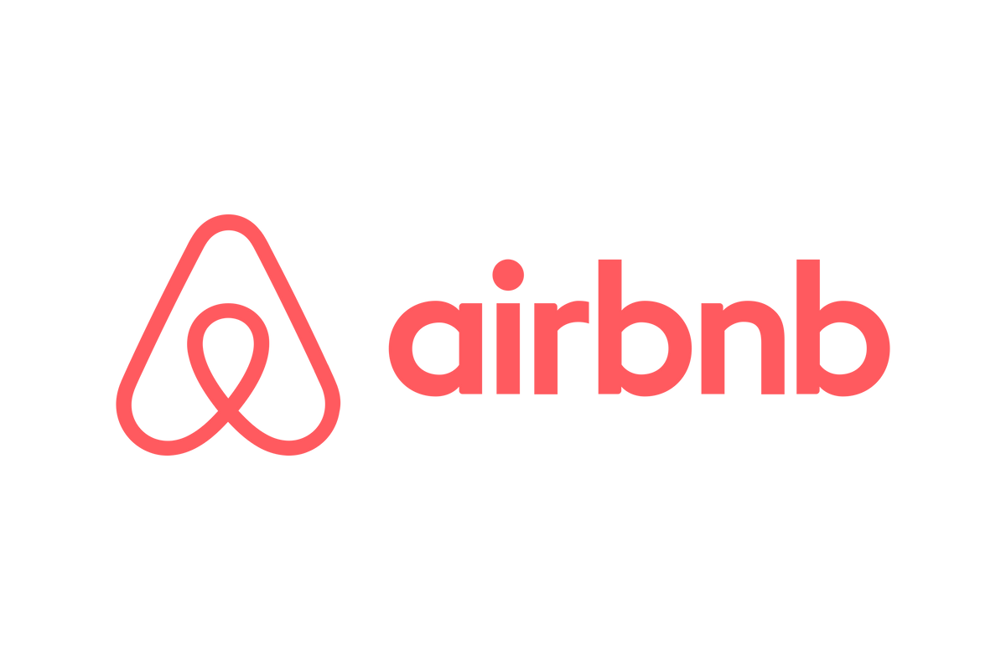
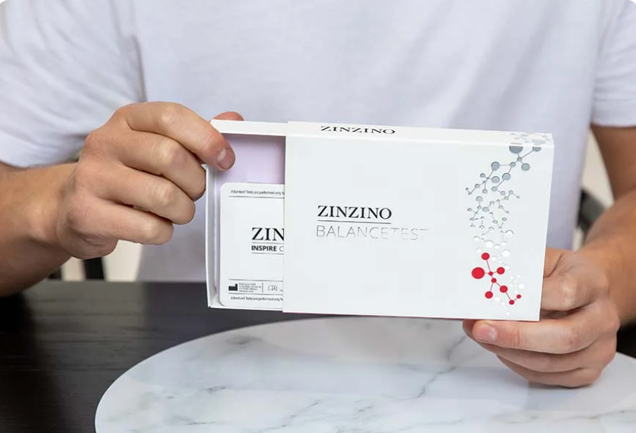

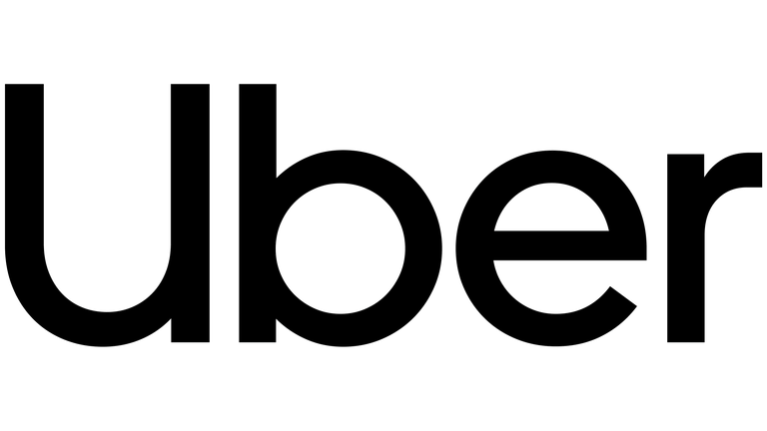
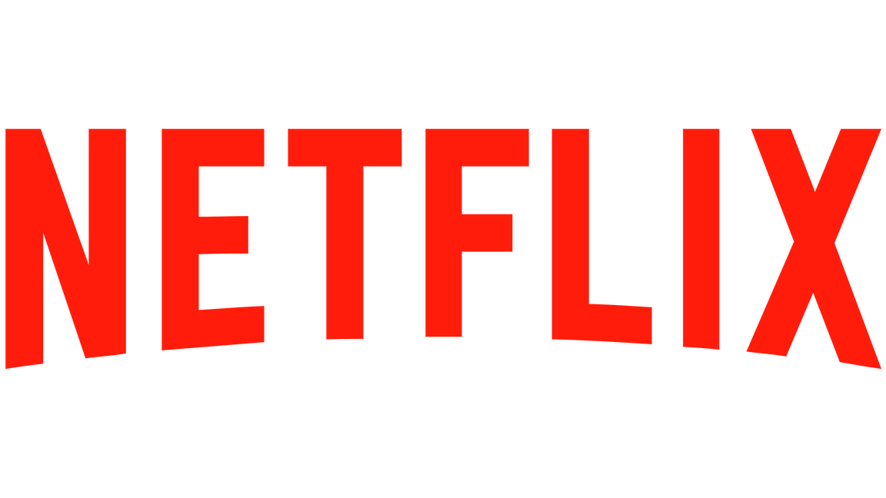

THE PROBLEM
The biggest business opportunities solve problems no one else is solving
next
Notes:
hink about the most disruptive companies of our time.
They didn’t just improve an industry—they changed the game by solving a problem no one else was solving.
And most of us didn’t even know it was a problem…
until someone fixed it so brilliantly, we couldn’t imagine going back.
Airbnb turned empty homes into vacation spots.
Amazon made convenience the new standard.
Uber gave us rides on demand with a tap.
So where does Zinzino fit in?
Right there—with the disruptors.
And I mean that.
Because what we’re doing is just as bold.
Just as game-changing.

Slide 4
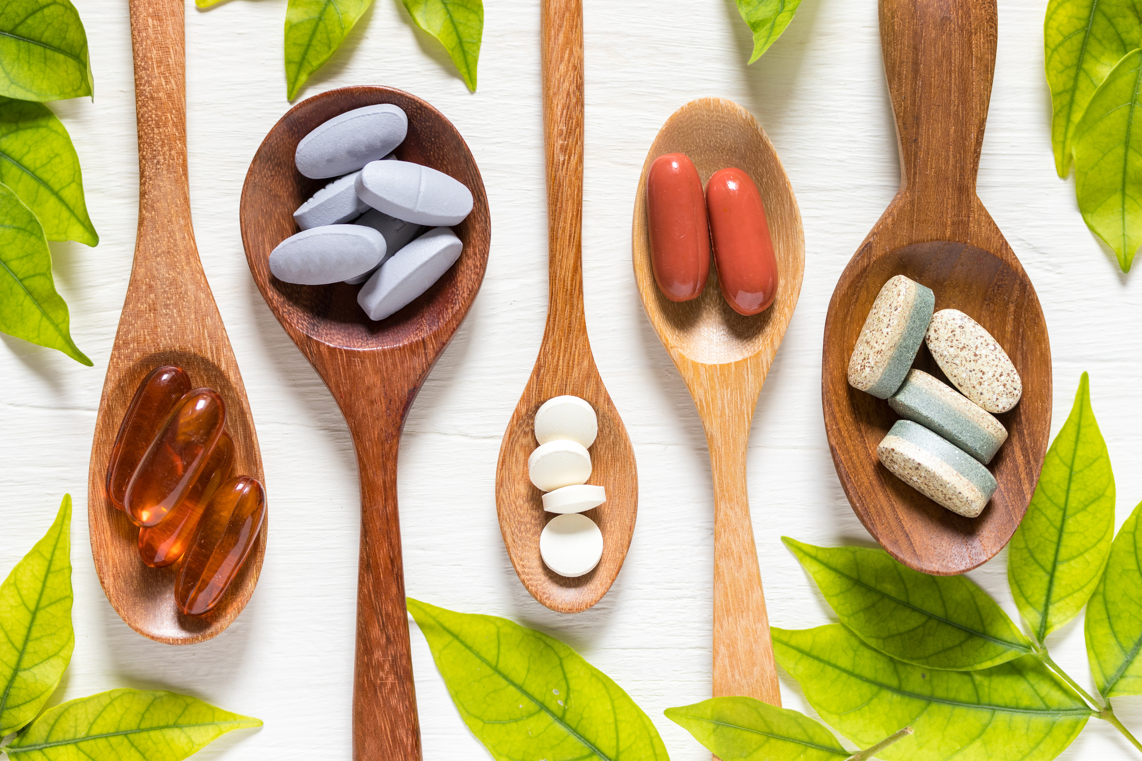
THE PROBLEM
How many people take supplements and believe they’re working?
Zinzino is a solutions-based company, solving a massive existing problem.
MOST OF US
How many people know for sure?
NONE OF US
Notes:
So now you know who we are—
Let’s talk about the problem we’re solving.
Here’s the deal:
The wellness space is full of noise—and zero proof.
(click)
People believe their supplements are working.
(click)
But how many actually know?
(click)
Basically no one.
We’re throwing money at pills and powders, hoping for the best.
No tests. No tracking. No idea what our bodies even need.
That would never fly in medicine—but in wellness? It’s the norm.
Zinzino flips the script with TEST=-BASED NUTRITION.
.
We’re a solutions-based company that introduced a new standard:
Test-based nutrition.
Built on proof. Driven by data.
You don’t have to convince people—just show them their results.
When you can measure the problem, you can solve it.
And that’s the power of this system.

Slide 5

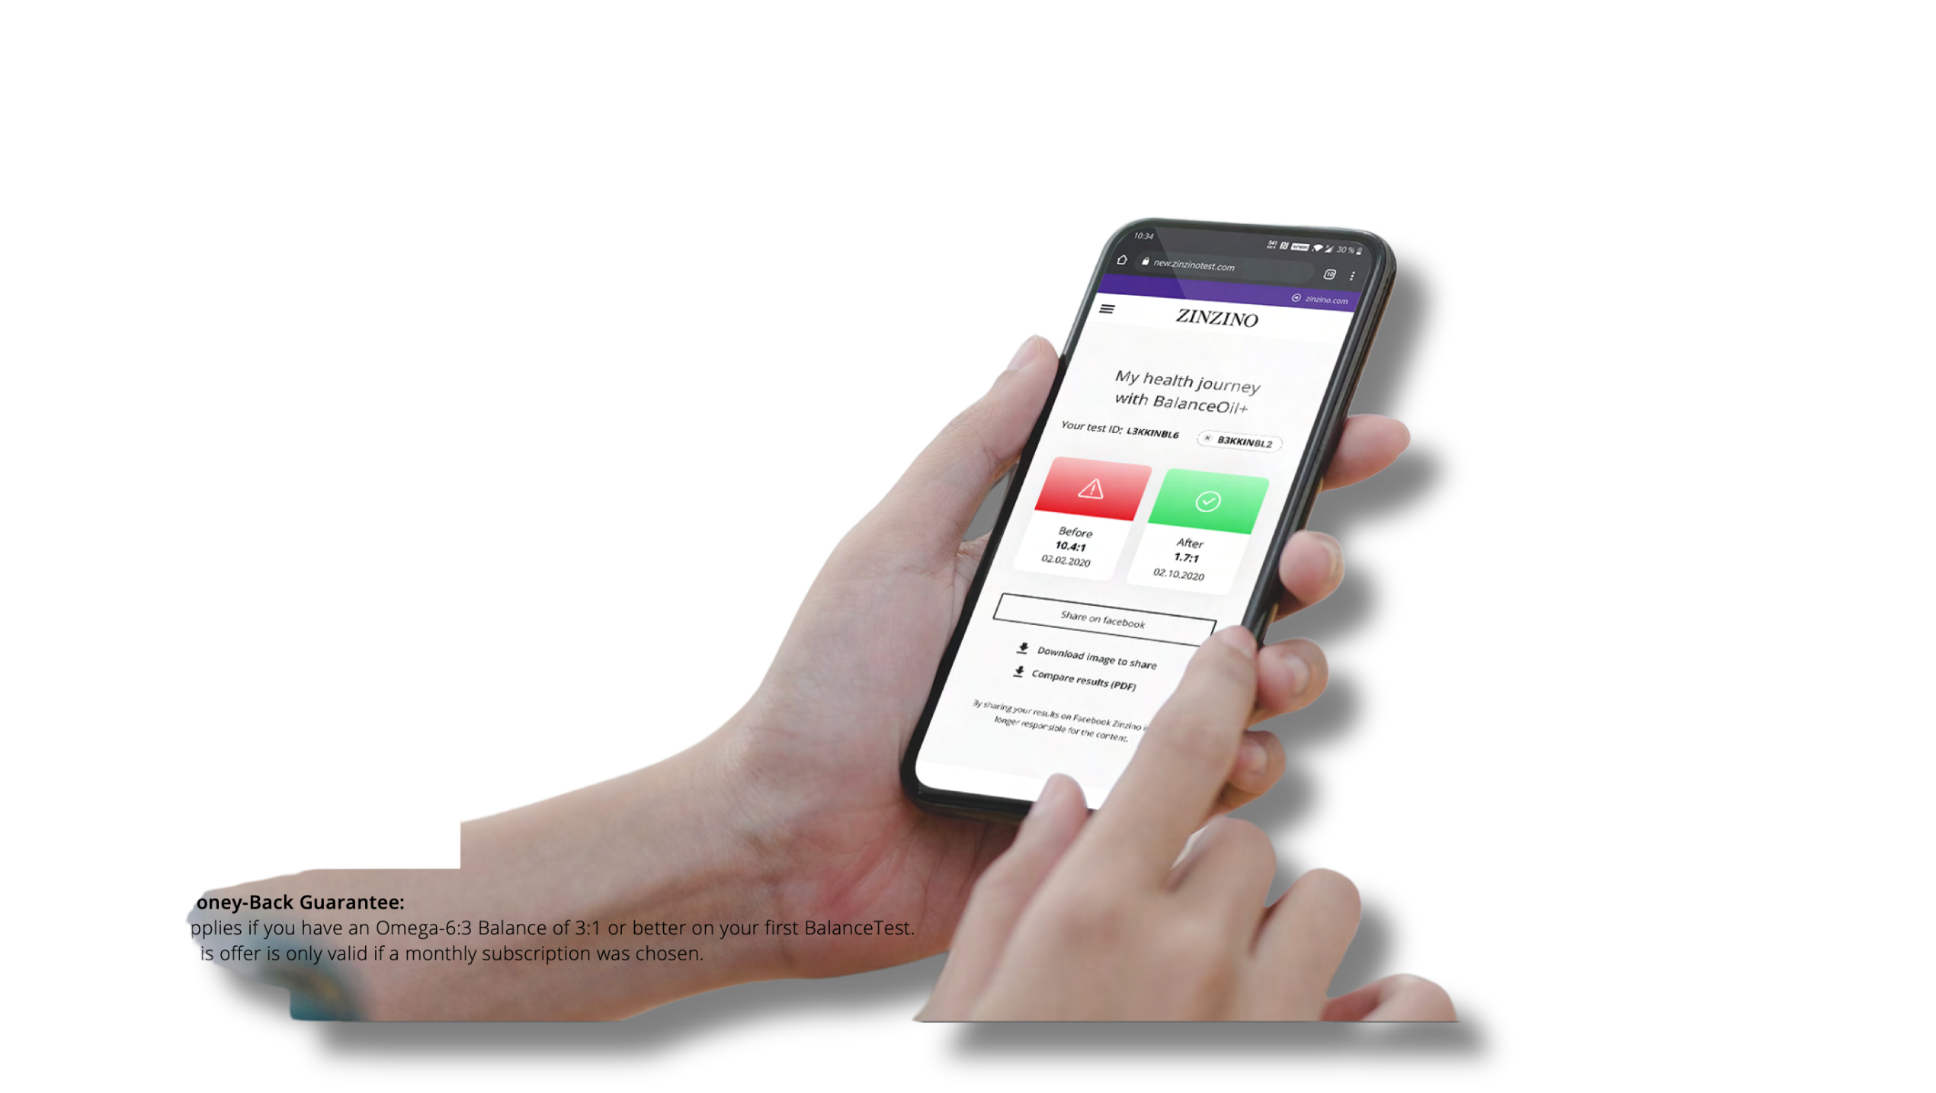
TEST, DON’T GUESS
HOPE
BELIEF
KNOWING
Notes:
What you just saw isn’t theory. It’s what we’re doing—every day.
We’re helping people stop guessing and start measuring.
That shift—from hope to belief to knowing—it does something bigger than we realize.
It changes how people engage with their health.
It builds confidence. It creates ownership. It leads to results.
And when that starts happening at scale?
It opens the door to something much bigger than individual wellness.
Let’s talk about that.

Slide 6

OUR MISSION
Measurably move the dial on public health.
Notes:
Our mission is bold: We want to measurably move the dial on public health, and we mean that literally.
Because every test gives us a number.
And every time that number improves, someone’s health is improving too.
And when you multiply that across families, communities, entire countries—
That’s a ripple effect that changes the world.

Slide 7
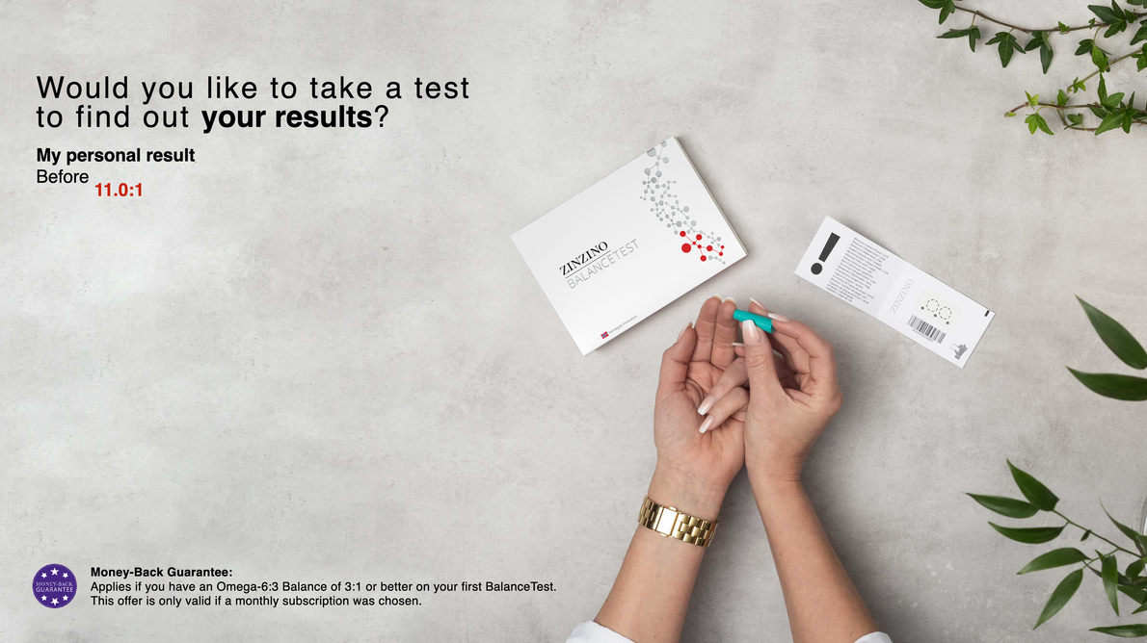
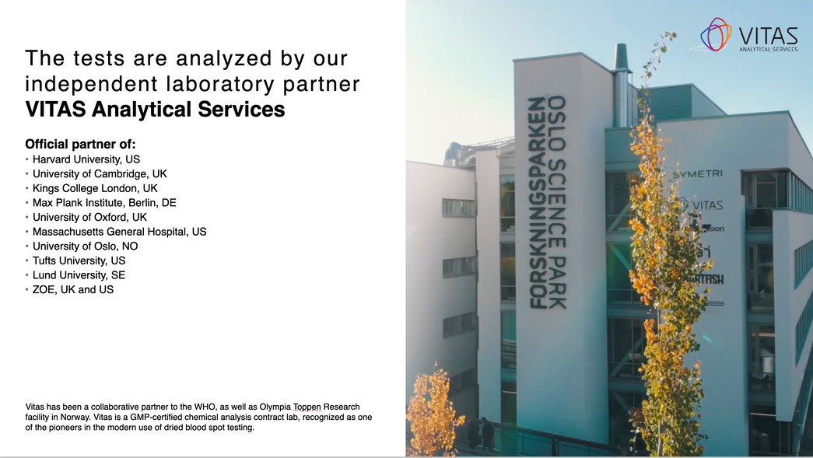
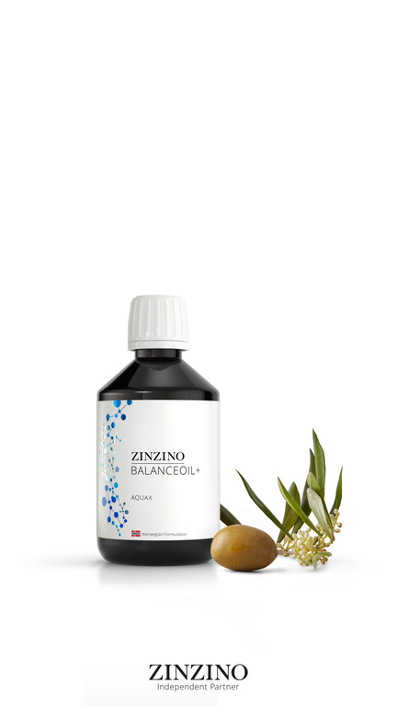
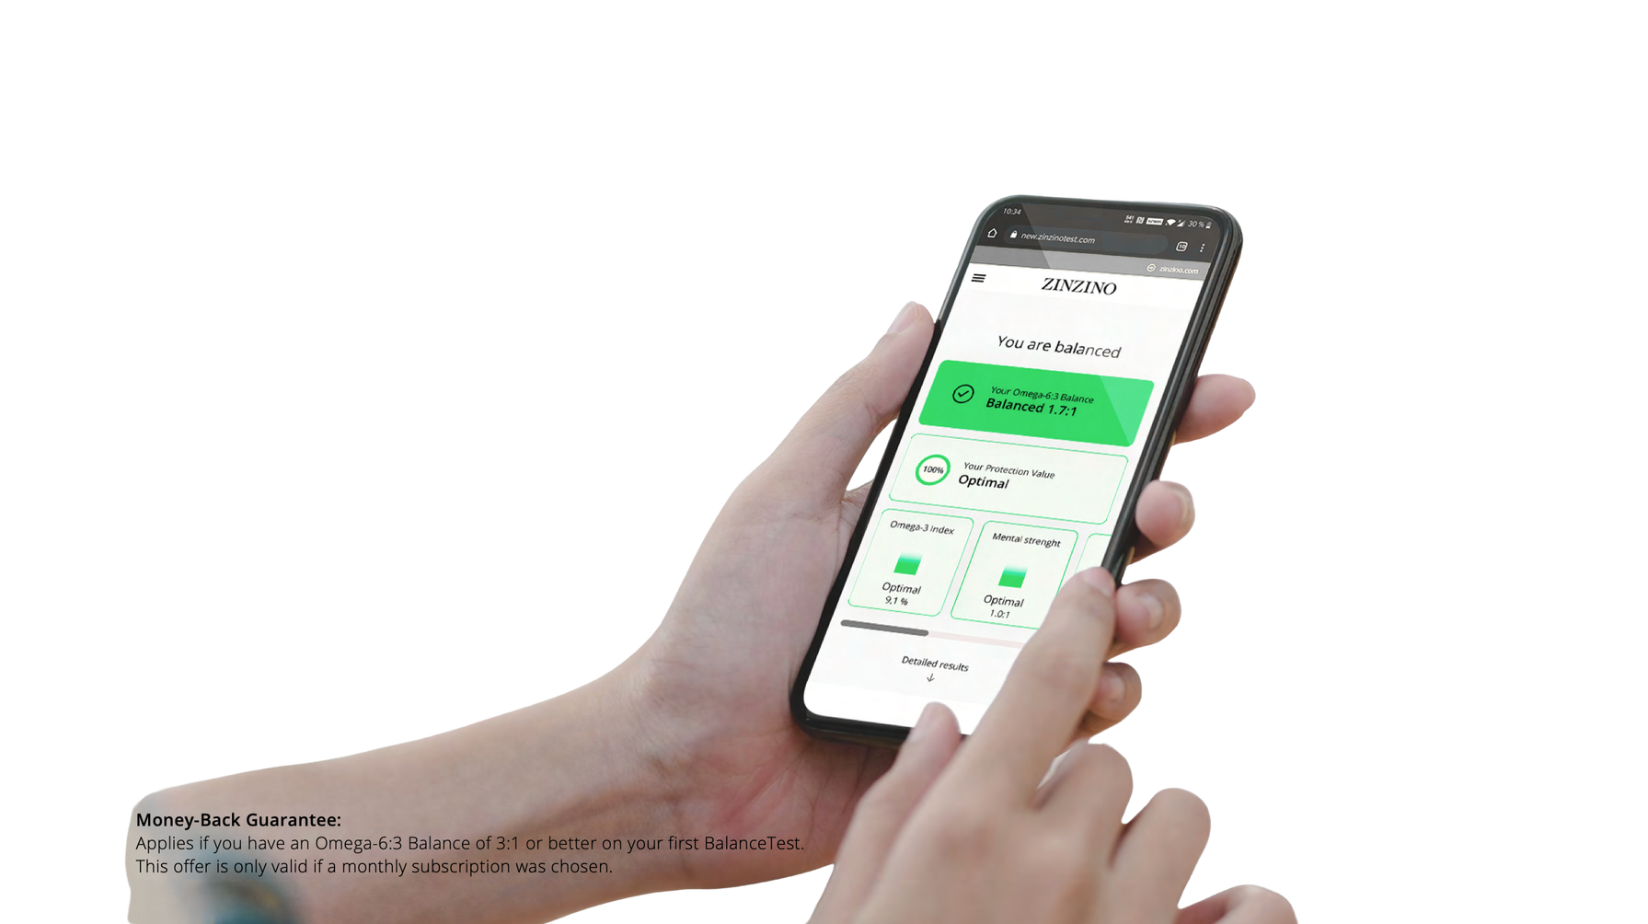
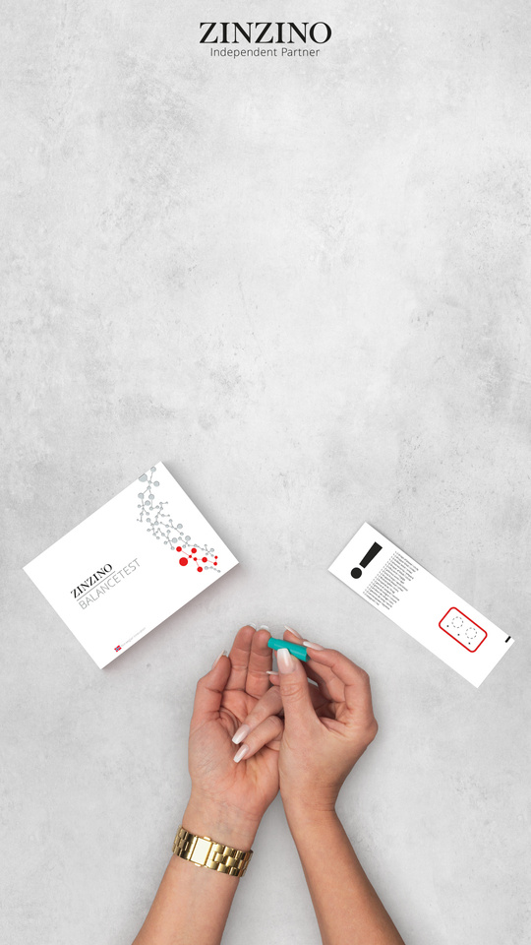
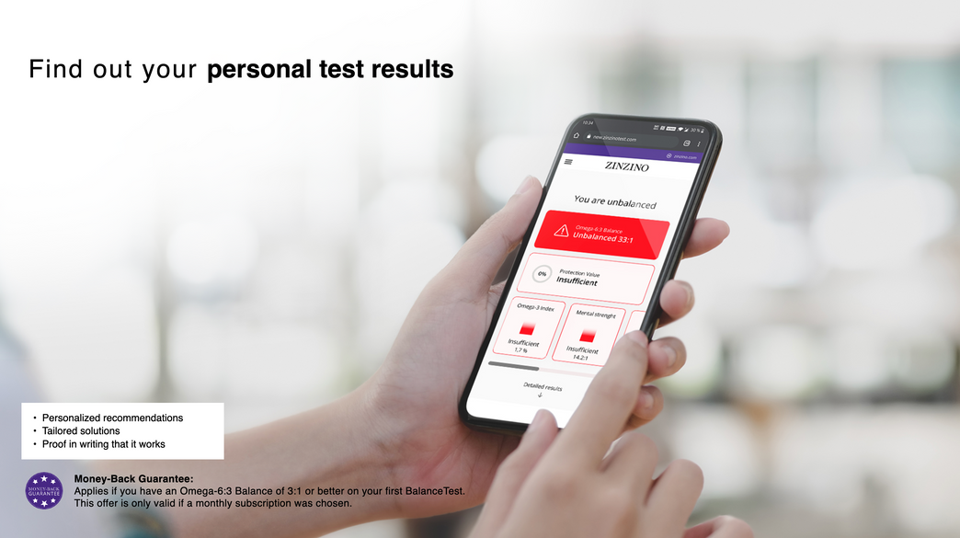
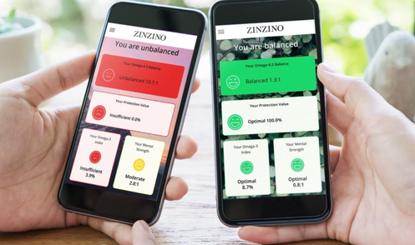
TESTING AND PROOF
The Customer Experience
Take a dried blood spot test at home
Send test to Vitas Lab in Norway for anonymous analyzation
Begin your supplement regimen
Continue taking your supplements for 120 days
20-25 days after testing, you’ll receive your results so you can see your baseline
Retest to see the measurable improvement in your health
Notes:
Here's how that ripple gets started. One person, one test at a time.
It begins with a simple at-home finger prick—just two drops of blood.
Each test is registered to a private, anonymous code.
(click)
That sample is mailed to Vitas Analytical Services in Oslo, Norway.
They’re the global gold standard in dried blood spot analysis.
(click)
While your results are processing, you’ll begin your personalized supplement routine.
No guesswork—just targeted support based on science.
(click)
About 15 to 20 days later, you’ll use your private code to access your results online.
You’ll see exactly where your baseline is—clear, measurable data that’s easy to understand and act on.
(click)
Then, after 120 days on the protocol, you retest.
Not to see IF it worked—but to see HOW WELL it worked.
So let’s talk about what we’re actually testing for—
and why it matters more than most people realize.

Slide 8
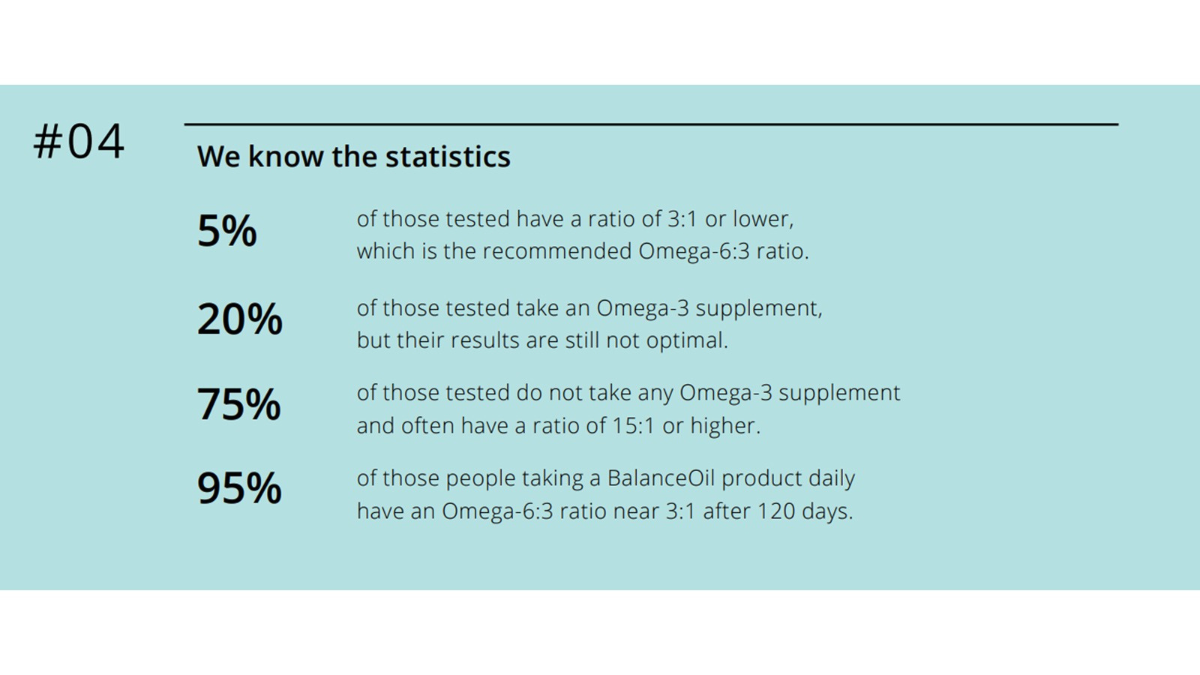
TESTING AND PROOF
We Know the Statistics

Slide 9
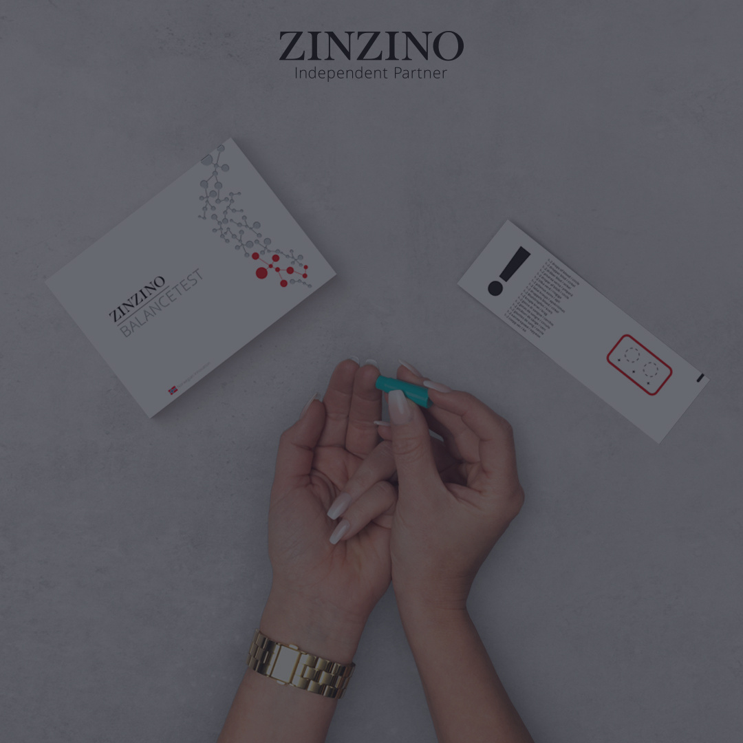
THE SILENT THREAT MOST PEOPLE MISS:
Imagine if you could offer a test every person needs !
Notes:
At Zinzino, we offer three health tests today—with two more on the way.
But if I could put just one in the hands of every person on the planet, it would be this:
The Balance Test.
It measures your Omega-6 to Omega-3 ratio—
One of the clearest indicators of chronic inflammation in the body. And chronic inflammation is a silent driver behind so many health issues.
But here's the thing: Most people have never heard of the Omega Balance ratio.
But I believe this will be one of the next major biomarkers—right up there with blood pressure and cholesterol.
Because this test lets you catch the problem before the symptoms.
Before the diagnosis.
Before it spirals.
Let’s look at the science.

Slide 10
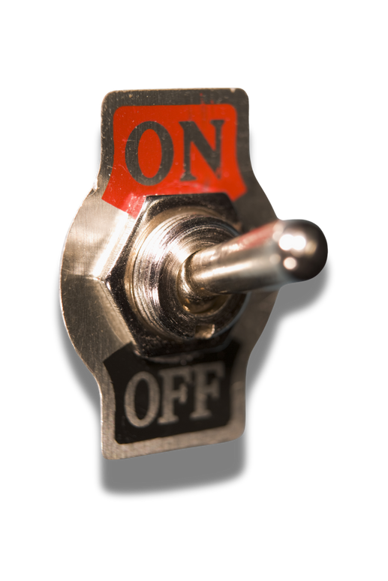


The Hidden Health Crisis
OMEGA-6
OMEGA-3
Essential
Essential
Your body doesn’t produce it.
Your body doesn’t produce it.
Largely proinflammatory
Largely anti-inflammatory
Notes:
SO Let’s talk about these
Essential fatty acids.
Specifically: Omega-3 and Omega-6.
THEY'RE BOTH ESSENTIAL NUTRIENTS. Your body can’t produce them.
You have to get them through food or supplements.
And they're both directly tied to inflammation.
Omega-6 activates inflammation when needed. It fliups the switch in your cells.
CLICK
That’s not a bad thing—it’s how the body responds to damage or stress.
But that switch isn’t meant to stay on.
Omega-3 flips it back. It REDUCES inflammation.
It tells the cell: “We’re safe now. You can stand down. Let’s begin healing.”
The problem?
Most people today are getting flooded with Omega-6 and almost no Omega-3.
So the switch stays on.
And the cell stays in defense mode—low-level, chronic inflammation that quietly chips away at your health.
Until symptoms show up... long after the damage began.

Slide 11
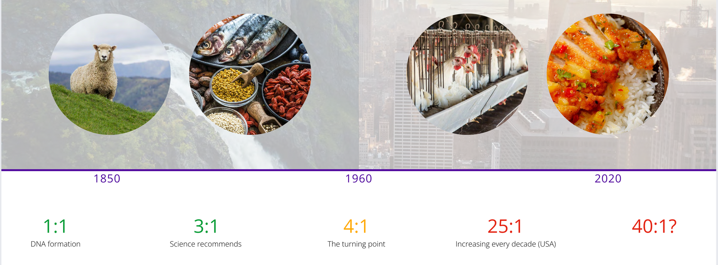
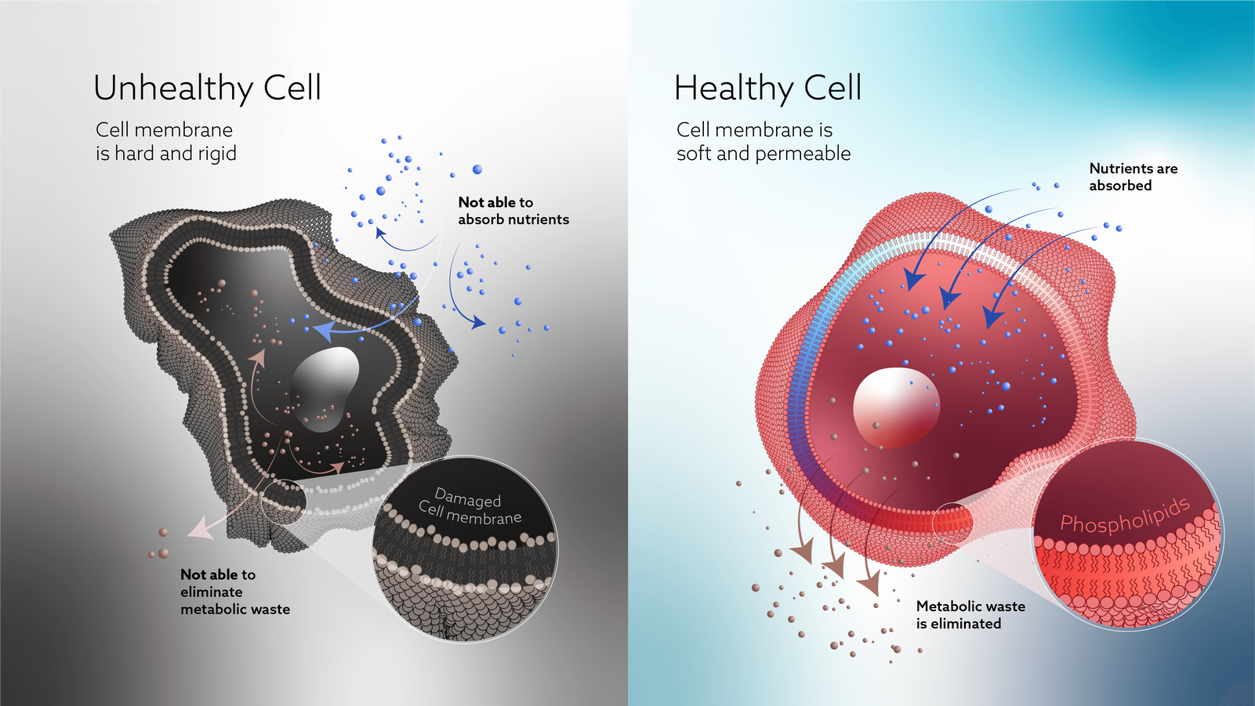
The Most Important Number
1:1
3:1
4:1
25:1
40:1
DNA Formation
Science Recommends
Turning Point
TODAY
?
3:1
is ideal
25:1
is average
Source: Vitas Analytical Services, Oslo, Norway – Analysis of over one million dried blood spot tests (Zinzino BalanceTest Data)
Notes:
So what’s the ideal balance?
Science shows that our bodies function best at around a 3:1 ratio—Omega-6 to Omega-3.
That’s the level our ancestors maintained for thousands of years.
(click)
At 3:1, your cell walls are soft and permeable.
Nutrients get in. Waste gets out. The body works the way it’s supposed to.
But today?
(click)
Today, the average person is walking around with a ratio of 25:1 or higher.
That’s not just a little off—that’s a completely different environment inside the body.
(click)
So what happened?
It started in the 1960s—when industrial farming, processed foods, and cheap seed oils flooded our food supply.
Omega-6 became the dominant fat. Omega-3 all but disappeared.
(click)
And when there’s too much Omega-6?
Cell walls get stiff. Nutrients struggle to enter. Toxins can’t escape.
The body stays in defense mode. Inflammation builds—slowly, quietly—until symptoms finally surface.
Now here’s the big question:
How many people are walking around like this—and have no idea?
Let’s take a look.

Slide 12

MIDDLE EAST
100% should take the test
NORTH AMERICA
EUROPE
98%
99%
AFRICA
95%
99%
97% fail the test globally
98%
ASIA
99% fail the test in the USA
97%
SOUTH AMERICA
Notes:
Zinzino has now run over one million Omega Balance Tests around the world.
And here’s what we found:
97% of people are out of balance.
In the U.S., it’s even higher—99%.
Now here’s the part that really matters:
These numbers include people who were already taking Omega-3s.
People eating clean. People doing “all the right things.”
They were still failing the test.
And that was a moment of truth for me.
Because if the Omega-3 I was already using actually worked—
Shouldn’t my test have shown that?
It didn’t.
So maybe the issue isn’t just about taking Omega-3—
Maybe it’s about taking the right kind.
And that’s exactly what we’re going to unpack next.

Slide 13

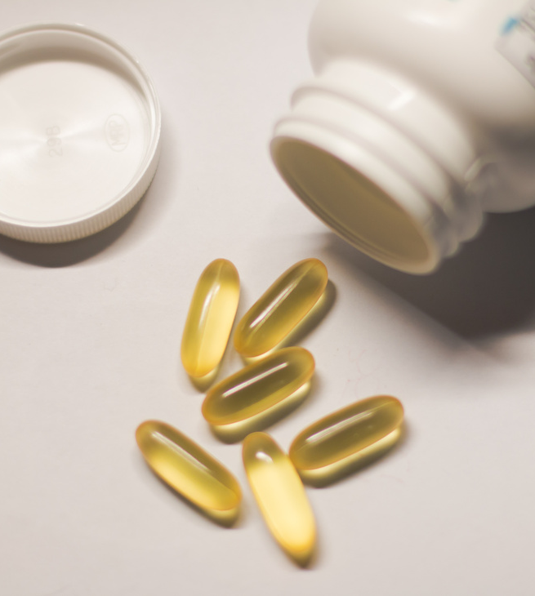
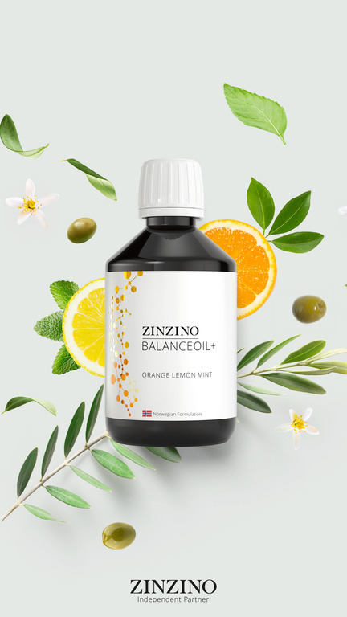

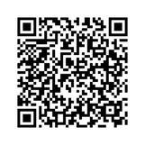
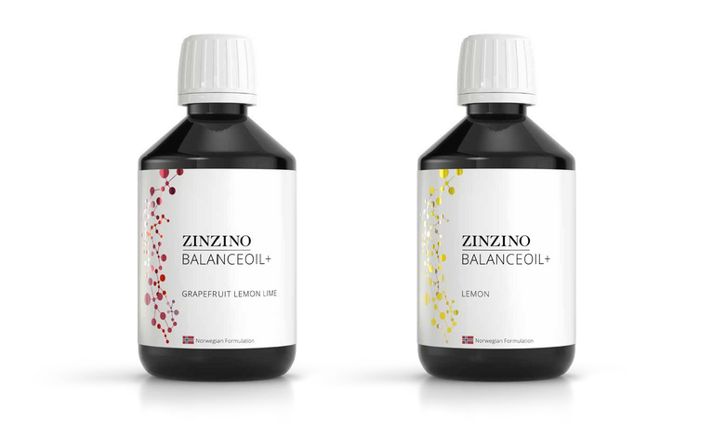
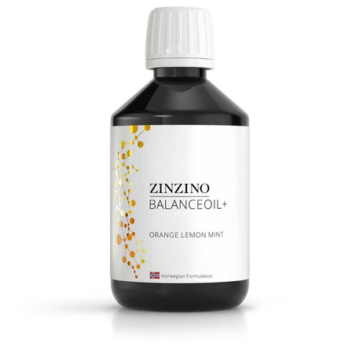
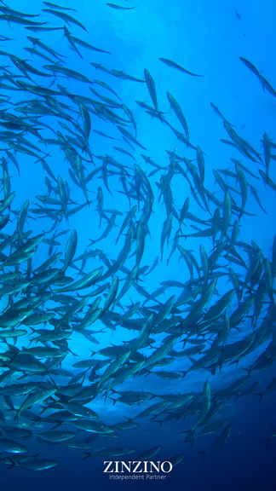
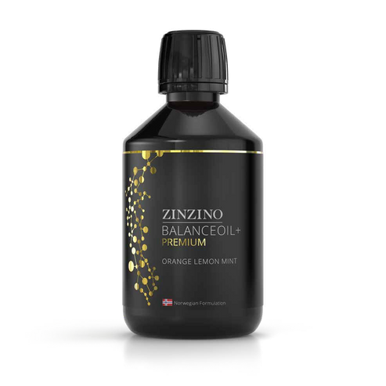
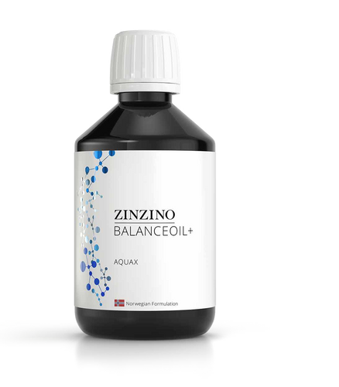
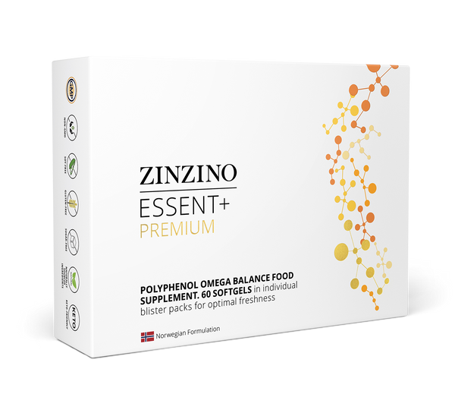

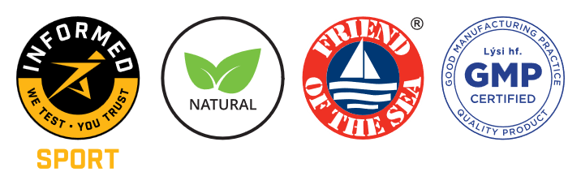
Balance Oil+
The Innovation Behind the Results
TRADITIONAL FISH OIL
BALANCE OIL
VIDEO: WHAT MAKES BALANCE OIL DIFFERENT
60% WILD-CAUGHT FISH
60%
Ultra-purified, sustainably sourced fish oil is free of toxins and contaminants
  NO POLYPHENOLS
  Low Absorption
  High levels of oxidation
  Lower potency
  Short shelf life
  Improperly purified
  Generic dosing
We Have Revolutionized the Fish Oil Industry
40% PRE-HARVEST OLIVES
40%
Pre-harvest olive polyphenols restore the antioxidants lost in fish oil refining
Omega-3
EPA
DHA
DPA
Omega-7 700 mg
PER 12 ML
2500 mg
PER 12 ML
1300 mg
PER 12 ML
700 mg
PER 12 ML
150 mg
PER 12 ML
Notes:
So let’s talk about what actually DOES work.
Remember how Dr. Colin Robertson told us the research showed most Omega-3s aren’t making it into the cells?
Let me show you WHY. It all comes down to one word: POLYPHENOLS.
(click)
During the fish oil refining process, polyphenols—the natural antioxidants that protect Omega-3s—are stripped away.
Without them, the oil becomes unstable.
It oxidizes. It breaks down. And the body can’t absorb it properly.
THAT'S why people taking “good” Omega-3s were still failing their test.
Zinzino found a way to ADD THE POPYPHENOLS back IN.
CLICK
After years of research, they discovered a rare olive harvested just before ripening—packed with the same polyphenols fish oil needs to stay protected.
CLICK
So they combined 60% wild-caught, ultra-purified fish oil
with 40% pre-harvest olive oil rich in polyphenols.
The result?
Omega-3s that stay stable, absorb properly, and actually reach your cells—just like nature intended.
And most importantly?
Proven to restore balance.
BalanceOil+ is the only Omega-3 supplement in the world with clinical results showing it actually works—measured by a before-and-after blood test.
That’s not marketing. That’s science.

Slide 14
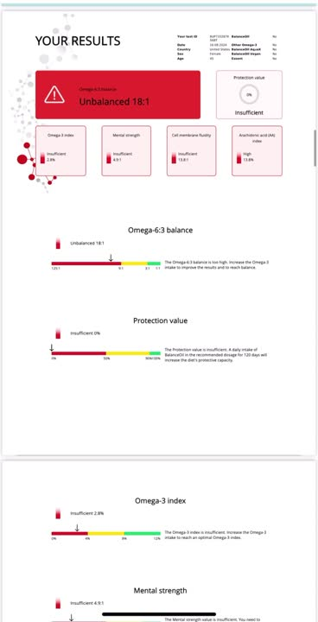
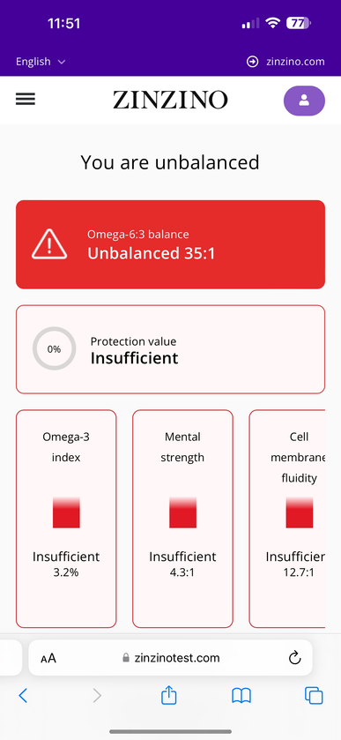
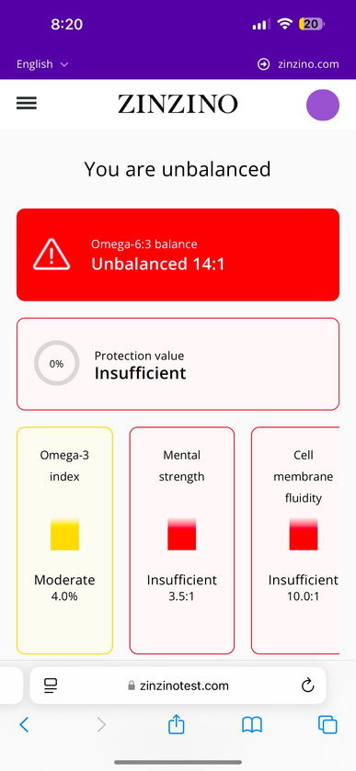
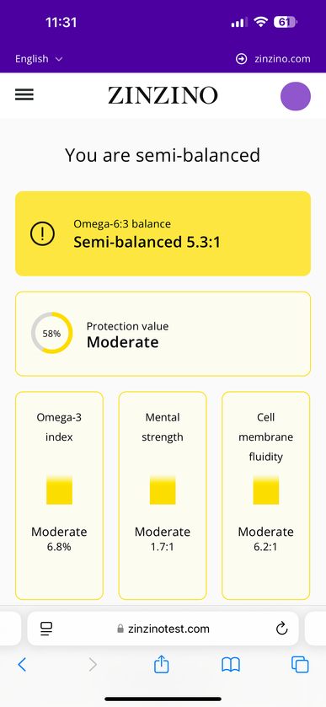
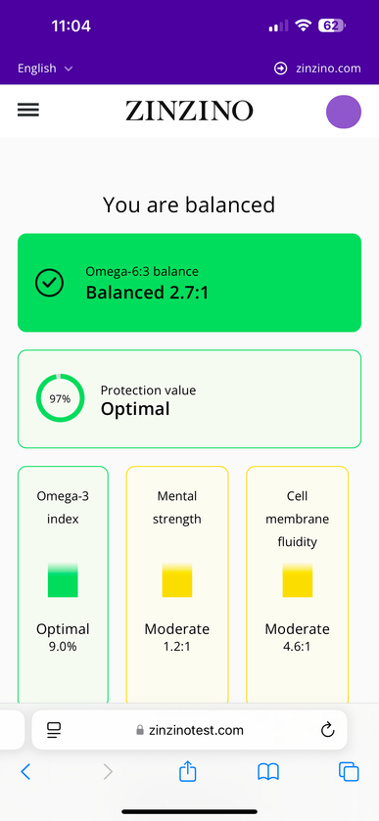

Balance Oil+
Results in 120 Days
Provides data about your Omega-6:3 Balance
START
30 days
60 days
120 days
Notes:
So what does the proof actually look like in the client experience?
Let me show you.
Now technically, you’re only supposed to test every 120 days.
But I’m curious—so I tested every 30.
I wanted to see what was really happening in my body.
Not just how I felt—but what the data showed.
And each time, I got a full, comprehensive report.
Not just a score, but a breakdown of what was improving and what still needed work.
✔ At the start, I was way out of balance.
✔ At 30 days—still out of balance, but things were shifting.
✔ By 60 days, I was climbing into the semi-balanced range.
✔ And by 90 days—I was almost at that ideal 3:1 ratio.
And then by 120 days? I felt it.
✔ I was sleeping better.
✔ My focus was sharper.
✔ My joint pain had eased.
✔ I just felt clearer.
The number told the story. But so did my body.
And here’s the thing—I’m not the only one.

Slide 15
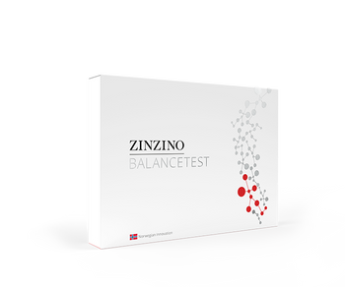

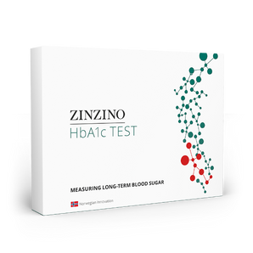
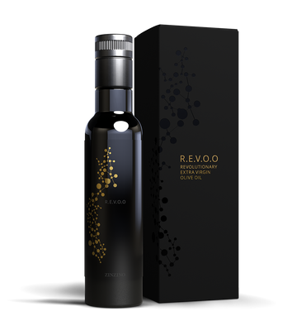
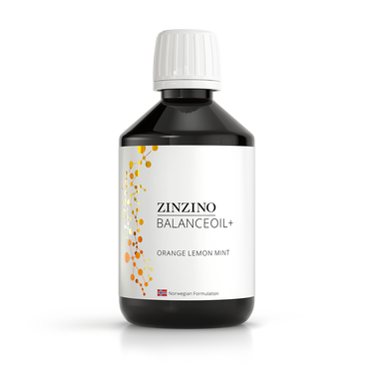
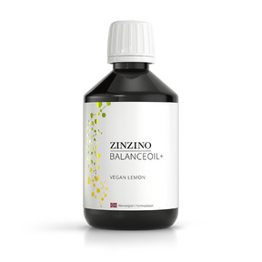
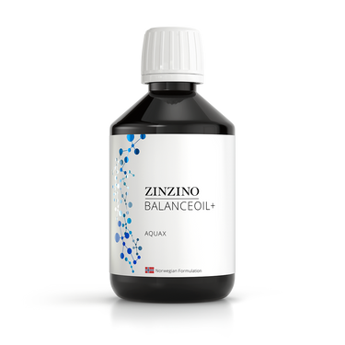
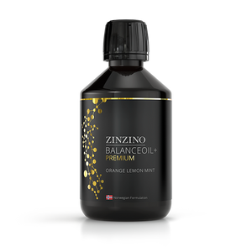


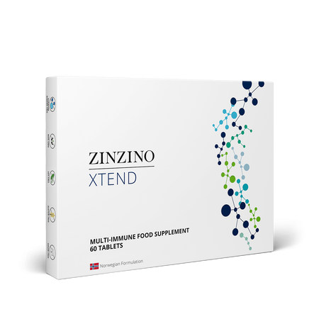
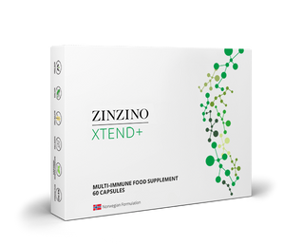
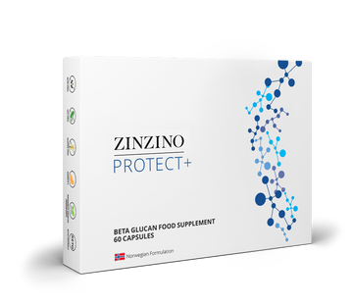
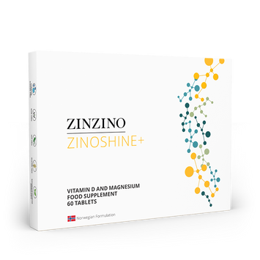
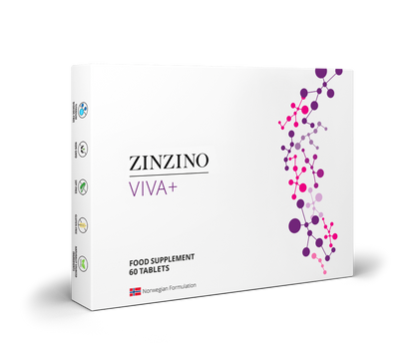










Product Portfolio
Dry blood testing
BalanceTest
Vitamin D Test
HbA1c Test
Balance supplements
BalanceOil+
BalanceOil+ Vegan
BalanceOil+ AquaX
BalanceOil+ Premium
Essent+ Premium
R.E.V.O.O
Immune and restore
supplements
Xtend
Xtend+
Protect+
ZinoShine+
Viva+
ZinoGene+
Multify
Gut health and
other wellness products
ZinoBiotic+
LeanShake
Energy Bar
Collagen Boozt
Skin Serum
Hanzz+Heidii
Notes:
In addition to Balance Oil, we have a complete portfolio of some of the highest quaity supplements on the market. Every product is designed to work together—supporting a balanced body from the inside out.
We offer three dried blood spot tests:
✔ The Balance Test
✔ A Vitamin D Test
✔ And an HbA1c Test for long-term blood sugar markers
From there, we have a full system of targeted supplements:
✔ Immune support
✔ Gut health
✔ Brain health—like Viva
✔ And skin health with our marine-based CollagenBoozt andSkin Serum.

Slide 16


Timing Right?
Is the
Right?
Notes:
We’ve just walked through the biggest piece of the puzzle:
The problem, the science, and the solution.
That’s the foundation.
So now I want to turn your attention to something just as critical:
Timing.
Because being early? That changes everything.

Slide 17







Why This Creates
Massive Opportunity
Notes:
The research has been out for years.
But the public? They’re just now starting to notice.
It’s showing up in headlines, podcasts—some doctors are beginning to talk.
And that’s what makes this moment so powerful
Zinzino isn’t following the trend.
We’re leading it.
We’re already testing, educating, and delivering results.
And when this goes mainstream—because it will—
Zinzino will be miles ahead.
The question is: Will you be ahead too?

Slide 18

IS THE TIMING RIGHT?
Ahead of the curve
PRE-TREND
TREND
Sweden
Norway
Finland
Denmark
Iceland
Estonia
Latvia
Lithuania
1.5%
2.5%
51,000+ tests to date
The United States:
5 Million Tests
(1 Billion in Sales)
8.2 Million Tests
Notes:
H
What you just heard from Colin—that’s not theory. That’s where we’re going.
And this is why NOW matters.
When you combine a one-of-a-kind solution with perfect timing,
you create something big: an early adopter opportunity.
And if you’ve watched any major wellness trend take off—
Oura Rings, fasting, cold plunges—
you know the power of catching it early. They were TRENDS that became mainstream.
Right now, test-based nutrition is at that same tipping point.
(click)
To officially qualify as a trend, just 2.5% of the population has to be aware of it.
(click)
Zinzino’s main markets? We’re at 1.5%.
(click)
In the U.S., we’ve barely scratched the surface—just 45,000 tests.
(click)
To hit 1.5% here, we’d need over 5 million test. That’s $1B in revenue.
(click)
8.2 million gets us to official “trend” status.
So yes—this is early.
We’re testing for the next big biomarker before most people even know it exists.
And the ones who recognize it now?
They don’t chase the future.
They get to lead it.

Slide 19
Company Solid?
Is the
Right?
Notes:
H
Now let’s move to the third question—
Is the company solid?
Because opportunity is only as good as the engine behind it.
You want to know—
Is this a stable company with staying power?
Is the model working?
Is demand growing?
Let’s take a look at the trajectory… and the numbers behind it.

Slide 20


IS THE COMPANY SOLID?
Trajectory
The
An Established Company,
Positioned to Win
  The foundation is set.
  The model is working.
  The demand is rising.
Notes:
When I looked at Zinzino, I wasn’t looking for hype. I didn't want to be part of a startup or a trend.
I was looking for infrastructure, scalability, and timing.
And what I found was rare: a publicly traded company that already built the system most brands are still trying to figure out.
And then I saw this growth curve.
This is momentum—33% average growth per year, over 60% last year.
But what makes this so powerful isn’t just the numbers—
It’s WHERE WE ARE on the curve.
CLICK
We’re still early. But not unproven.
And from here? It scales. Fast.
1 million customers now.
20 million by 2035.
100 million by 2050.
If you’ve ever said, “I wish I had gotten in earlier…”
This is earlier.
And this time, you know what you’re looking at.

Slide 21







Net Profit
Gross Profit
EBITDA
$528,976
$528,976
$528,976
This Period
This Period
This Period
IS THE COMPANY SOLID?
Financial Overview
Revenue
Cash Reserves
Gross Profit
Operating Profit
$269.2M USD
31% YoY
$41M USD
$11M
$20.79M
59%
59%
$6.59M
Projected in 2025 (Q1 Anualized)
This Period
Quarter 1 2025
Q1 2025
Stock Price Growth
(shares)
Sales Growth
534%
25%
Over the last five years
Over Q1 2024
Notes:
But what really sealed it for me?
The financials.
Zinzino isn’t just growing fast—it’s growing smart.
They’re projecting $269 million in revenue this year. That’s 31% year-over-year growth—which is impressive by any standard.Z
They’ve got over $41 million in cash reserves, up 11 million—
which means they’re growing without debt. Cushion to grow.
But here’s where it really caught my eye:
Gross and operating profit are both up 59% in the last year.
And if you’ve been in business, you know—
that kind of growth and profitability at the same time is rare.
And the stock?
Over the last five years, it’s up 534%.
That tells you everything.That’s not just a number.
That’s a signal.
Because stock growth reflects more than just revenue.
It reflects confidence—from the market, from investors, and from leadership.
It means this isn’t just a health company—it’s a solid business.
And they’re still early in the U.S.All this momentum. All this financial strength.
And we’re just getting started here.
So. If you’re looking for something with real upside—and real stability behind it?
Well, You’re looking at it.

Slide 22
Win here?
Can I
Right?
Notes:
Which leads us to our last question: Can I win here?
Does this actually pay?
Yes. Let's talk about how.

Slide 23







CAN I WIN HERE?
10 - 30% on New Customer Orders
Earning Potential
  More Customers = Higher Percentage
TWO PATHS TO RESIDUAL INCOME:
Free Products
  4 Customers: Your products are free
  25+ Customers: $115/month in free products
Monthly Customer Bonuses
CUSTOMER PLAN
PARTNER PLAN
Earn by selling products to customers through your online store.
Start building a team of distributors, and earn overrides on their businesses.
25
50
100
200
$115
$230
+ one time $11,500 bonus
$460
$1150
+ luxury trip
Features
Notes:
There are two ways to earn with Zinzino:
The Customer Plan and The Partner Plan. You don't choose one or another. You can tap into BOTH.
Let’s start with the Customer Plan—because if you just want to share products and earn from customer orders, here’s exactly how it works:
You get a free online store, ready to use.
You earn 10 to 30% on customer orders—
And the more customers you serve, the higher your payout.
Once you hit 25+ customers, you also receive $115 in monthly product credits.
So your own wellness routine is covered just by helping others.
But it gets better:
There are monthly customer bonuses as your base grows.
And when you reach 100 customers, you earn a one-time $11,500 bonus on top of your monthly pay.
For some people, that’s exactly what they’re looking for—
Simple, sustainable income by helping people get healthier.
But for others?
Those who want to build a team, grow something big, and unlock serious scalability?
That’s where the Partner Plan comes in.
Let’s take a look at that next.

Slide 24

CAN I WIN HERE?
Earning Potential
TEAM COMMISSION:
Earn 10-15 % overriding residuals on your entire network of online stores
TWO PATHS TO RESIDUAL INCOME:
  $230 / month phone bonus
  $1150 / month car bonus
  Title rank advancements
  Luxury vacations
  Shares of Zinzino Stock for achieving President and above
CUSTOMER PLAN
PARTNER PLAN
Earn by selling products to customers through your online store.
Start building a team of distributors, and earn overrides on their businesses.
Notes:
Now let me paint the bigger picture.
You start just like before—sharing products through your free online store.
(click)
But then you introduce a few people who want to do the same.
They become partners. They start building their customer base. Their own momentum.
(click)
Then they bring in a few more partners.
(click)
And now you’ve got something bigger than effort—
you’ve got duplication.
You’re not just earning on what you do—
you’re earning on what duplicates.
And that’s where the power is.
Because Zinzino uses a binary compensation plan,
you override it all. That volume?
It flows up through your structure—
and you’re paid weekly. Like clockwork.
There’s no other industry I know that lets you compress a 30-year career into five.
That’s the power of leveraged income.
And once it starts to build, it gets exciting—fast.

Slide 25

Getting
Started
Notes:
If you’re feeling that pull—the “this might be for me” nudge—
Let me show you how simple it is to get started.
You don’t need to know everything.
You just need to take the first step.
Let me show you exactly how it works.

Slide 26



Select a Partner Kit
Notes:
The first step is choosing a Partner Kit.
We’ve got three main options—and each one gives you the core products, tools, and support you need to start strong.
But if I can be honest with you?
There’s one kit I recommend every time—and that’s the Ultimate Partner Kit.
Here’s why:
It gives you a full experience—not just a few products to sample, but a chance to actually use Zinzino in your home, with your family, and feel what we’re talking about.
Most importantly?
It comes with 10 Balance Tests.
Those tests are normally $179 each in the U.S.—so the value alone is a no-brainer. But more than that, those 10 tests become your most powerful business tool.
Because when someone sees their number… everything changes.
So if you're serious about this?
The Ultimate Kit isn’t just the best value.
It’s the smartest way to start. Especially with our current campaign.

Slide 27


Ultimate Partner Kit Refund Campaign
US$1,150
Retail price US$3,165
Get a full loyalty refund when acquiring 25 Premier Customers within a year of purchasing the Ultimate Partner Kit*
Get your money back:
Basic and Advanced Partner Kits can be upgraded during the first 6 months to get the refund.
* Read all the details in our Ultimate Partner Kit Refund Campaign sheet.
Notes:
And right now?
There’s something else that makes the Ultimate Kit an even easier yes.
Zinzino is running a refund campaign.
If you choose the Ultimate Kit and stay consistent—
By your twelfth month, if you have just 25 products going out to customers,
Zinzino will refund the entire cost of your starter kit.
Let me say that again:
You’ll get back 100% of what you paid to start your business.
That’s not just generous—it’s smart.
Because 25 customers over 12 months?
That’s just over two a month.
It’s not only doable—it’s designed to set you up for a long-term, sustainable business.
So when I say the Ultimate Kit is the smartest way to start?
This just sealed it.

Slide 28

Select Your Monthly Auto-Order
Includes
      One Balance product of your choice every month
      One Test every 4 months (one BalanceOil+ Premium in New York)
      Powerful Back Office, easy-to-share landing pages
      GoCore App, for personal and professional development
      US$79 I Save 36% I 10 Credits
      Retail price US$123
Follow the program: In 120 days you will be in Balance and have proven before and after test results.
Notes:
Next, you’ll activate your own online store by setting up a subscription with the Z4F Premiere Kit—this is your only real overhead, and it’s $79 a month. It incudes one bottle of Balance Oil a month, and access to your Back Office.
That one step makes you an active partner and eligible to earn commissions on your team.
And that’s it.
$79 a month.
That’s your total cost to run a business with global reach, proven products, and weekly payouts.
And if you've ever spoken to a brick and mortar business owner, they'll be the first to tell you that $79 a month is a steal.

Slide 29





Get Your Products for Free
Love it. Share it. Get free products
  Subscribe to a Z4F Kit and share your product experience
  Enroll 4 or more subscribing Customers with a Premier Kit*
  Get your own monthly subscription (Auto Order) for free.
  All you pay is shipping.
Customer
YOU
Z4F
4 Premier Customers
Get paid
Partner
YOU
Z4F and get paid
*The credit value of your first generation Customers’ combined purchases must be at least 40 Credits.
Notes:
And here’s the best part: This monthly $79 is free once you have four active personal customers. That means you’re earning and saving at the same time.

Slide 30






Fast Start Program
TOTAL POTENTIAL INCOME: $2850 -$5000
4
2
4
10
25
FOUR PRODUCTS
TWO PARTNERS
FOUR TOTAL
10 PRODUCTS
25 PRODUCTS
YOU SELL FOUR PRODUCTS ON SUBSCRIPTION
SPONSOR TWO NEW PARTNERS
YOUR TWO NEW PARTNERS EACH DO THE SAME (SELL FOUR + BRING IN TWO)
SELL SIX MORE PRODUCTS ON SUBSCRIPTION
10 PRODUCTS TOTAL
YOU SELL FIFTEEN MORE PRODUCTS FOR 25 PRODUCTS TOTAL

Slide 31












CAN I WIN HERE?
Earning Potential
TEAM COMMISSION
Earn 10-15 % overriding residuals on your network of online stores
PARTNER PLAN
TITLE BONUSES
Earn up to 3 One-Time Bonuses per title ($150 - $120,000)
LUCRATIVE EXTRAS, EARNED WITH RANK:
CUSTOMER ACQUISITION BONUS
  $230 / month phone bonus
  $1150 / month car bonus
  Luxury vacations
  Shares of Zinzino Stock for achieving President and above
Earn CAB on new Customer Premier Kits and new Partner Product Kits.
MENTOR MATCHING BONUS
5-25% Matching Bonuses on personally enrolled Partners’ Team Commissions
VOLUME COMMISSION
1–4% of WCV paid weekly, when you reach the rank of Director or higher
Notes:
So what does earning look like when you build a team?
As a partner, you unlock multiple income streams that grow as your organization grows.
The biggest one?
You earn 10 to 15% in weekly commissions on the total volume from your entire team’s online stores.
And as your business expands, so do the rewards.
You can earn one-time title bonuses—some as high as $120,000.
And along the way, you pick up weekly customer growth bonuses,
mentor matching income on what your personally enrolled partners earn,
and even volume commissions on your total team sales once you reach Director and above.
But it doesn’t stop there.
Zinzino adds in fun extras like a monthly phone bonus,
a $1,150/month car bonus,
luxury incentive trips,
and even company stock when you reach the top ranks.
This is where leveraged income meets real lifestyle reward.
It’s designed to scale—and built to last.

Slide 32

In the life of a customer, no company even comes close to what Zinzino is doing.
In the life of a partner, there is no one who gets a home like the one they get in Zinzino.
Notes:
J
Final Thought: This Is It
Eleven years ago, I sat in a presentation like this—wondering if I should take the leap.
I said yes.
And it changed everything.
That decision opened doors I didn’t even know were closed.
It was one of the best decisions of my life.
And now—here we are again.
But this time, it’s even bigger.
Because no one else is doing what Zinzino is doing.
And what I’m going to build here—what we’re going to build—
is the legacy play.
So if something in you is saying “maybe”—
Open the door.
What’s the worst that could happen? Let's move the dial on global health TOGETHER.

Slide 33

Next Steps
✔ Become a Zinzino Partner – Lead the future of personalized nutrition and grow your impact.
✔ Schedule a Follow-Up – Let’s go over the details and find the best fit for you.
✔ Become a Zinzino Customer – Experience the benefits and get your health in balance.
✔ Connect Us With Others – Know someone who’d be interested? Introduce us—we’ll handle the rest.
Notes:
J
Let's bring it home: We started with four questions:
✔ Does it solve a real problem? Yes—and we proved it with science and results.
✔ Is the company solid? Absolutely—publicly traded, fast-growing, and built to last.
✔ Is the timing right? We're ahead of a global shift—still early, but not unproven.
✔ Can I win here? You can. Whether it’s free products or full-time income, there’s a path.
So now it’s your turn.
If you’re ready—we’ll walk with you.
If you’re curious—let’s talk more.
And if you’re passing—for now—send us someone who’s looking. We'll take great care of them.
This is the moment, friends.
Let’s build something massive together.
I prefer this response

Slide 34
OTHER SLIDES I MIGHT USE

Slide 35

CAN I WIN HERE?
Earning Potential

Slide 36

CAN I WIN HERE?
Earning Potential

